Slide 1
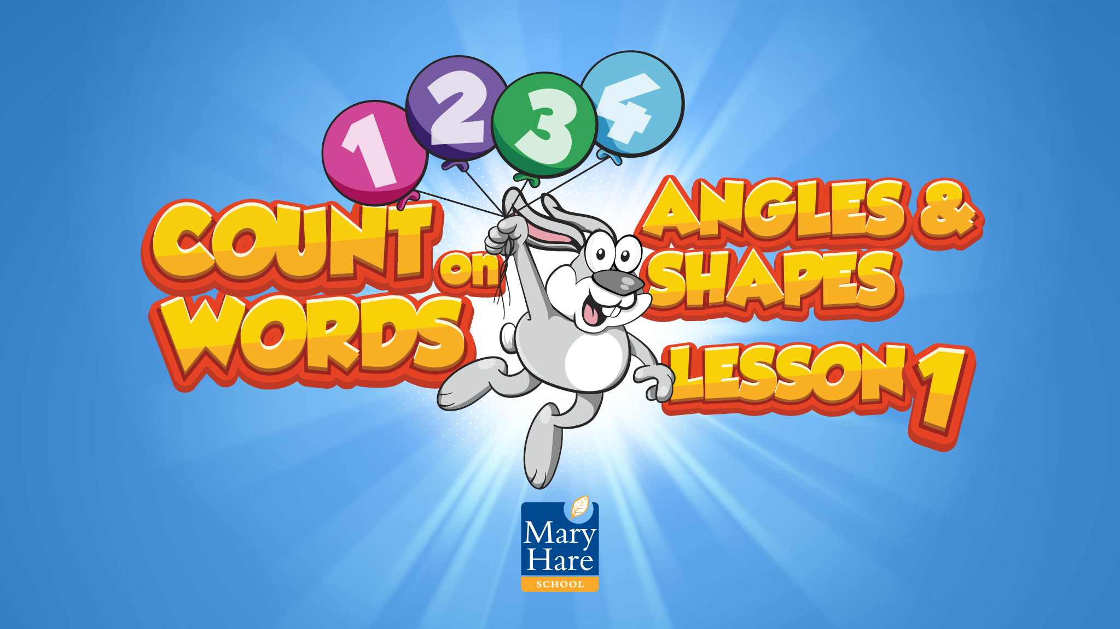

Slide 2

Notes:
Cold test
The vocabulary topic test is completed at the beginning of the intervention which will give a baseline and generate target words.
Students need to complete the missing word. They are given the first letter.
Give the full test or choose how many words to assess based on students needs/ability, e.g. just the first five words.
Apply students’ normal way of working, e.g. you can read the questions to the student.
When marking, allow 2 marks for a fully correct answer, 1 mark if the intention of the word is correct but there is a spelling or word variation error (e.g. day instead of days), 0 if wrong or blank. You will use the results from this to inform the Word Wizard activity.
Do not go through this assessment with the students after to avoid them becoming over familiar with the questions. Use the results to inform the words you focus on in the following lessons.​

Slide 3

Notes:
Mathematically Speaking
An opportunity to link the topic with other subjects and the wider world.
Let the students lead the discussion. Look for opportunities to include target words.
Conversation ideas: Picture of the Gherkin, London. What other interesting buildings do you know of?
Talk about Maths skills an architect might use, construction, plans and elevations, Pythagoras and trigonometry.
Name the shapes in the pictures.

Slide 4
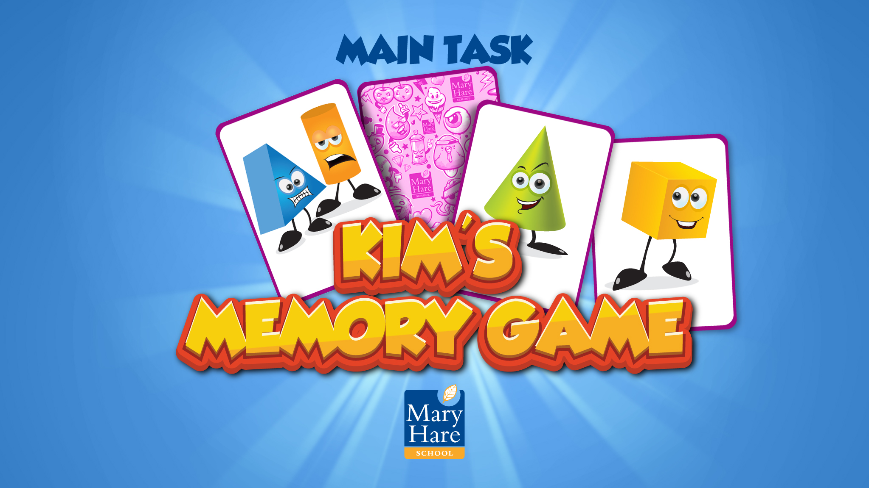
Notes:
Kim’s Game
This activity is designed to introduce each topic word. It will also start the process of committing them to memory.
To play the game memorise where the words are. One will be removed. Which one has gone?
12 of the 15 words have been included. Elevation, base and solid are not included.
You can edit this PowerPoint to change the words you want to include.

Slide 5


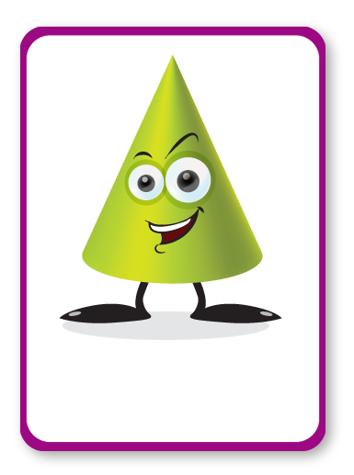










TRIANGLE
CONE
TRAPEZIUM
PRISM
POLYGON
CUBE
PARALLELOGRAM
SIDE
RIGHT ANGLE
SQUARE
TANGENT
CIRCLE
Notes:
Kim’s Game
Spend time discussing the pictures and words.
Why do you think this picture represents the word?
Look at definitions, pronunciation, spelling, links to Maths and other subjects, synonyms, antonyms, word variations, words with the same root etc.

Slide 6

TRIANGLE
CONE
TRAPEZIUM
PRISM
CUBE
PARALLELOGRAM
SIDE
RIGHT ANGLE
SQUARE
TANGENT
CIRCLE

Slide 7
TRIANGLE
CONE
TRAPEZIUM
PRISM
POLYGON
CUBE
PARALLELOGRAM
SIDE
RIGHT ANGLE
SQUARE
TANGENT
CIRCLE

Slide 8
TRIANGLE
CONE
TRAPEZIUM
PRISM
POLYGON
CUBE
PARALLELOGRAM
RIGHT ANGLE
SQUARE
TANGENT
CIRCLE

Slide 9
TRIANGLE
CONE
TRAPEZIUM
PRISM
POLYGON
CUBE
PARALLELOGRAM
SIDE
RIGHT ANGLE
SQUARE
TANGENT
CIRCLE

Slide 10
TRIANGLE
CONE
PRISM
POLYGON
CUBE
PARALLELOGRAM
SIDE
RIGHT ANGLE
SQUARE
TANGENT
CIRCLE

Slide 11
TRIANGLE
CONE
TRAPEZIUM
PRISM
POLYGON
CUBE
PARALLELOGRAM
SIDE
RIGHT ANGLE
SQUARE
TANGENT
CIRCLE

Slide 12
TRIANGLE
CONE
TRAPEZIUM
PRISM
POLYGON
CUBE
PARALLELOGRAM
SIDE
RIGHT ANGLE
SQUARE
TANGENT

Slide 13
TRIANGLE
CONE
TRAPEZIUM
PRISM
POLYGON
CUBE
PARALLELOGRAM
SIDE
RIGHT ANGLE
SQUARE
TANGENT
CIRCLE

Slide 14
TRIANGLE
CONE
TRAPEZIUM
PRISM
POLYGON
CUBE
PARALLELOGRAM
SIDE
RIGHT ANGLE
TANGENT
CIRCLE

Slide 15
TRIANGLE
CONE
TRAPEZIUM
PRISM
POLYGON
CUBE
PARALLELOGRAM
SIDE
RIGHT ANGLE
SQUARE
TANGENT
CIRCLE

Slide 16
CONE
TRAPEZIUM
PRISM
POLYGON
CUBE
PARALLELOGRAM
SIDE
RIGHT ANGLE
SQUARE
TANGENT
CIRCLE

Slide 17
TRIANGLE
CONE
TRAPEZIUM
PRISM
POLYGON
CUBE
PARALLELOGRAM
SIDE
RIGHT ANGLE
SQUARE
TANGENT
CIRCLE

Slide 18
TRIANGLE
CONE
TRAPEZIUM
PRISM
POLYGON
CUBE
PARALLELOGRAM
SIDE
RIGHT ANGLE
SQUARE
CIRCLE

Slide 19
TRIANGLE
CONE
TRAPEZIUM
PRISM
POLYGON
CUBE
PARALLELOGRAM
SIDE
RIGHT ANGLE
SQUARE
TANGENT
CIRCLE

Slide 20
TRIANGLE
CONE
TRAPEZIUM
PRISM
POLYGON
CUBE
PARALLELOGRAM
SIDE
SQUARE
TANGENT
CIRCLE

Slide 21
TRIANGLE
CONE
TRAPEZIUM
PRISM
POLYGON
CUBE
PARALLELOGRAM
SIDE
RIGHT ANGLE
SQUARE
TANGENT
CIRCLE

Slide 22
TRIANGLE
TRAPEZIUM
PRISM
POLYGON
CUBE
PARALLELOGRAM
SIDE
RIGHT ANGLE
SQUARE
TANGENT
CIRCLE

Slide 23
TRIANGLE
CONE
TRAPEZIUM
PRISM
POLYGON
CUBE
PARALLELOGRAM
SIDE
RIGHT ANGLE
SQUARE
TANGENT
CIRCLE

Slide 24
TRIANGLE
CONE
TRAPEZIUM
PRISM
POLYGON
CUBE
SIDE
RIGHT ANGLE
SQUARE
TANGENT
CIRCLE

Slide 25
TRIANGLE
CONE
TRAPEZIUM
PRISM
POLYGON
CUBE
PARALLELOGRAM
SIDE
RIGHT ANGLE
SQUARE
TANGENT
CIRCLE

Slide 26
TRIANGLE
CONE
TRAPEZIUM
PRISM
POLYGON
PARALLELOGRAM
SIDE
RIGHT ANGLE
SQUARE
TANGENT
CIRCLE

Slide 27
TRIANGLE
CONE
TRAPEZIUM
PRISM
POLYGON
CUBE
PARALLELOGRAM
SIDE
RIGHT ANGLE
SQUARE
TANGENT
CIRCLE

Slide 28
TRIANGLE
CONE
TRAPEZIUM
POLYGON
CUBE
PARALLELOGRAM
SIDE
RIGHT ANGLE
SQUARE
TANGENT
CIRCLE

Slide 29
TRIANGLE
CONE
TRAPEZIUM
PRISM
POLYGON
CUBE
PARALLELOGRAM
SIDE
RIGHT ANGLE
SQUARE
TANGENT
CIRCLE

Slide 30
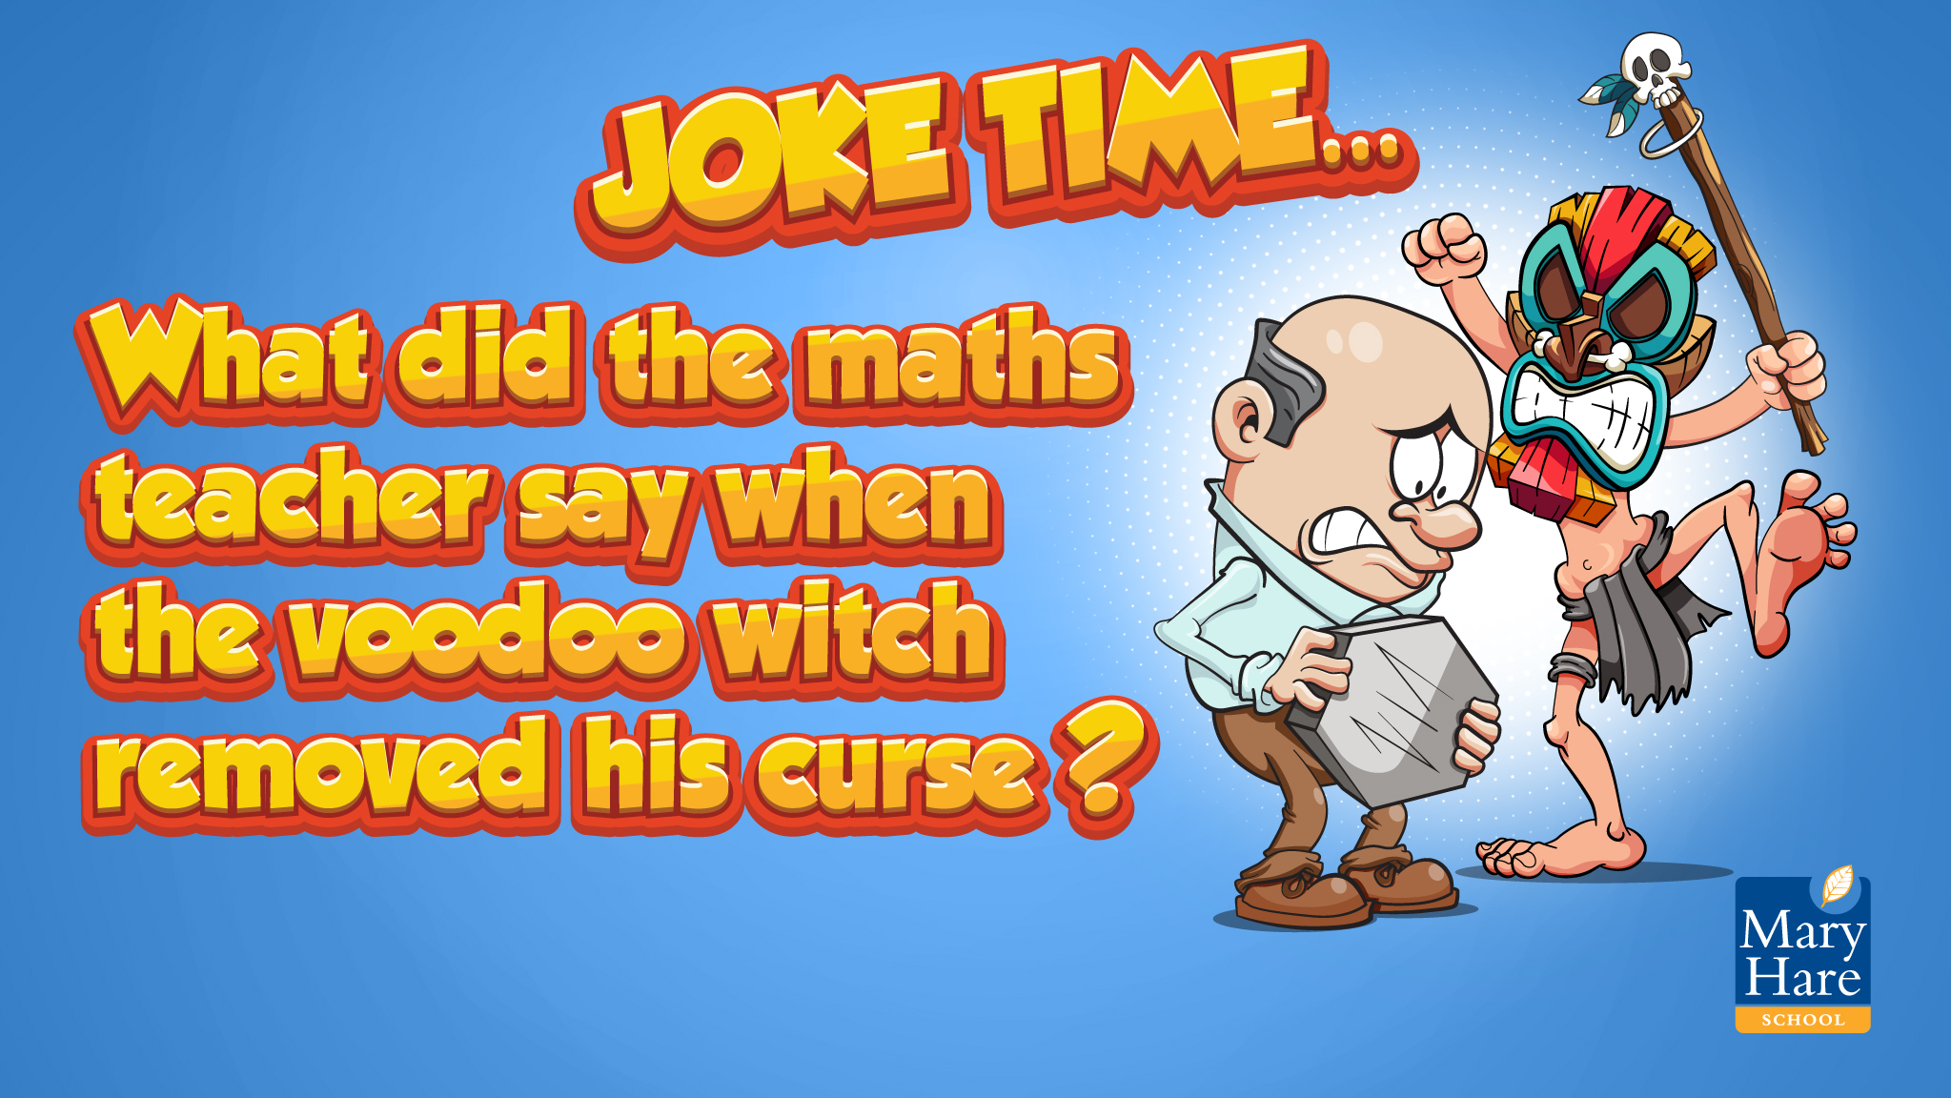
Notes:
Can students guess the punch line?

Slide 31
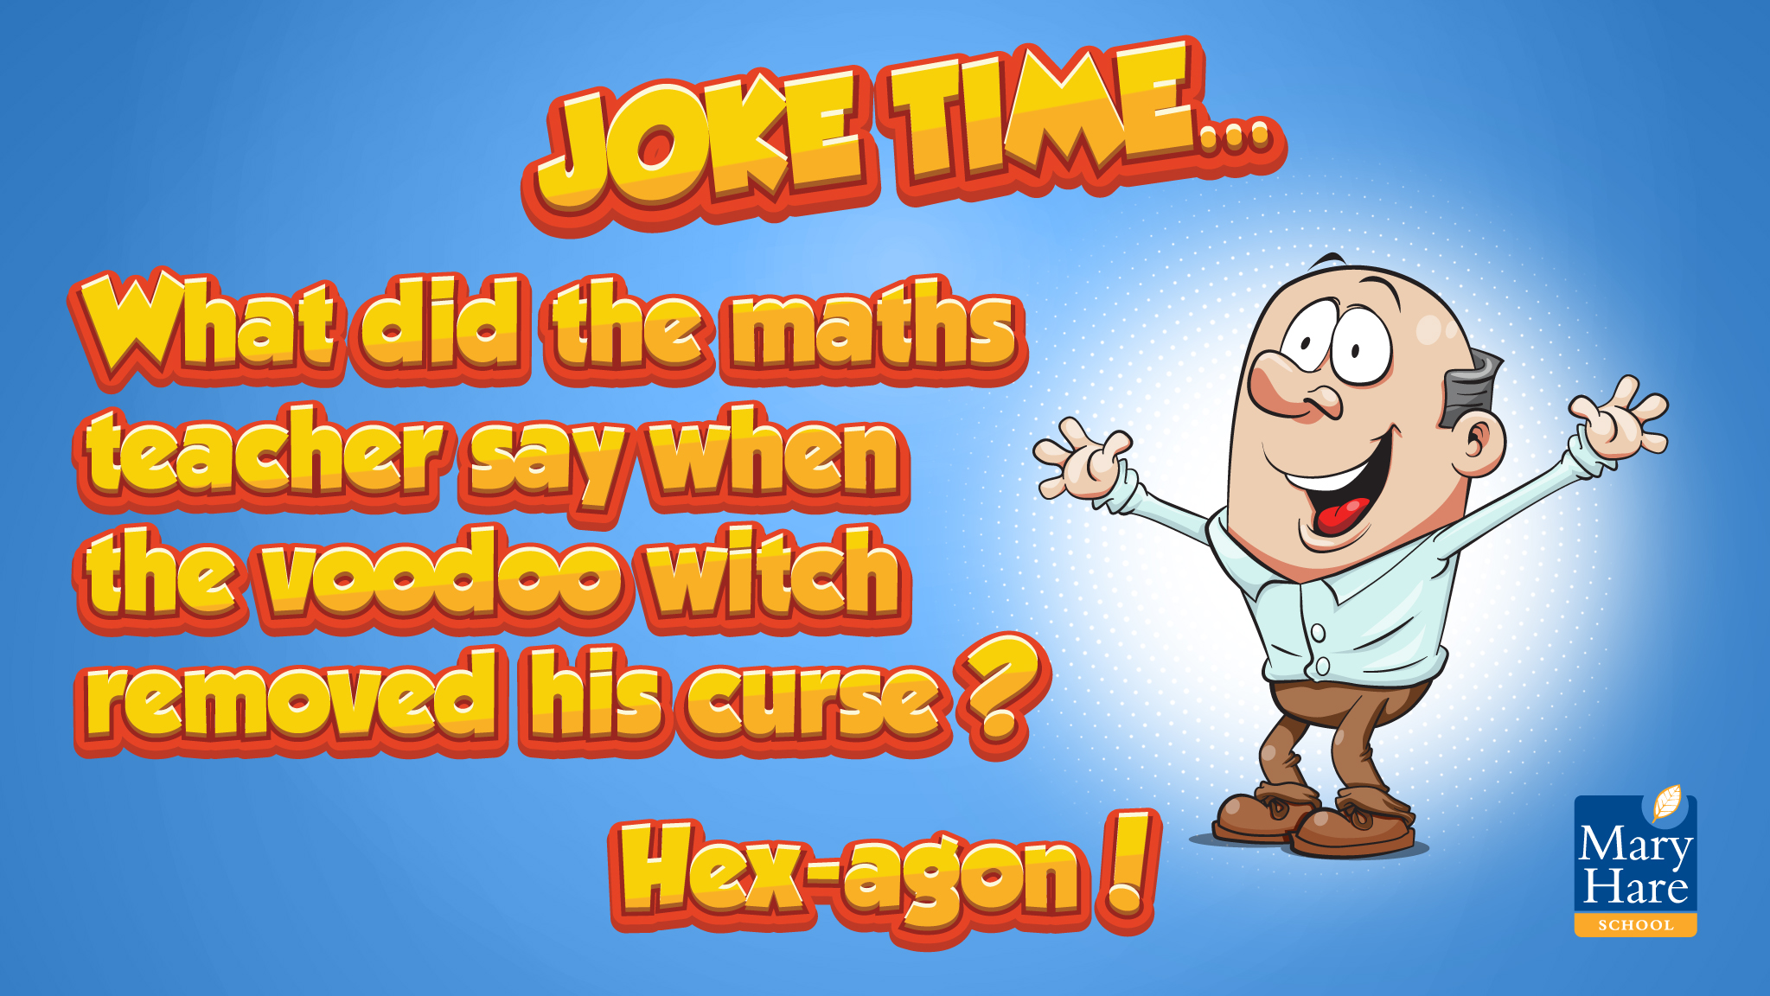

Slide 32

Notes:
I went to the market…
Working in small groups, a student names one of the topic words e.g. triangle, the next student has to repeat their word and name another e.g. triangle, square.
Continue for as long as the memory will allow!
You may want to display the words from Kim’s game to support the students.

