Slide 1
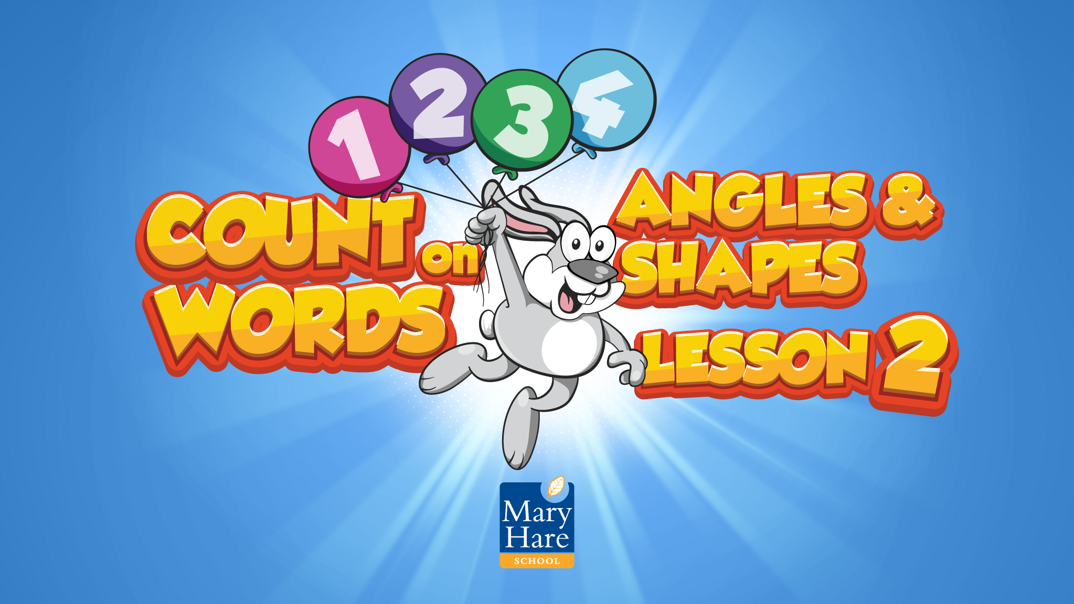

Slide 2
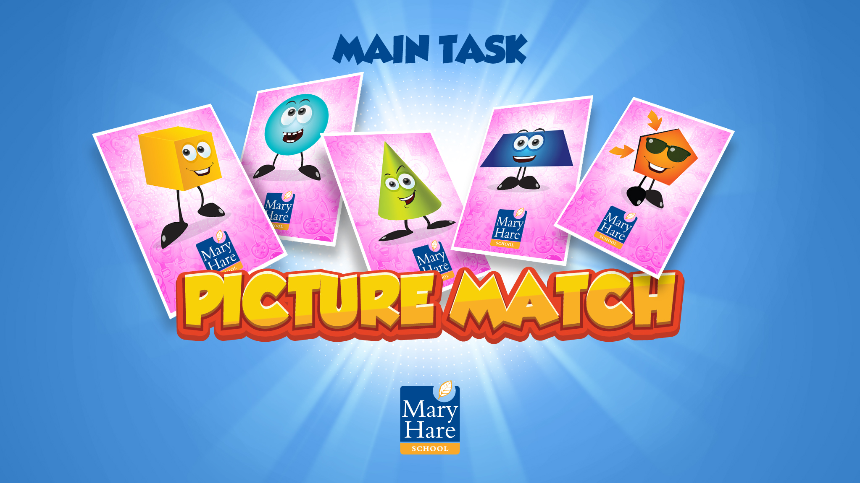
Notes:
Picture Match
You will need to prepare a set of word cards and a set of picture cards for each group/pair/individual.
It is worth taking time to produce these on card as they will be used repeatedly throughout the intervention.
Ask students to match the words to the pictures.
There may be several cards that match with each picture as the word cards include many word variations (different tenses, plurals etc).
Are there other words in the topic they can think of?

Slide 3

Notes:
Mathematically Speaking
An opportunity to link the topic with other subjects and the wider world.
Let the students lead the discussion. Look for opportunities to include target words.
Conversation ideas: In tennis think about the serve, the body, where the ball lands, how it bounces.
What other sports use angles? football, snooker, darts

Slide 4

Notes:
Word Wizard
Use the results from the cold test to choose a target word.
This works well if it’s the same word for every student but it may be more appropriate to have different words for different students.
Model completing the Word Wizard for the students.

Slide 5
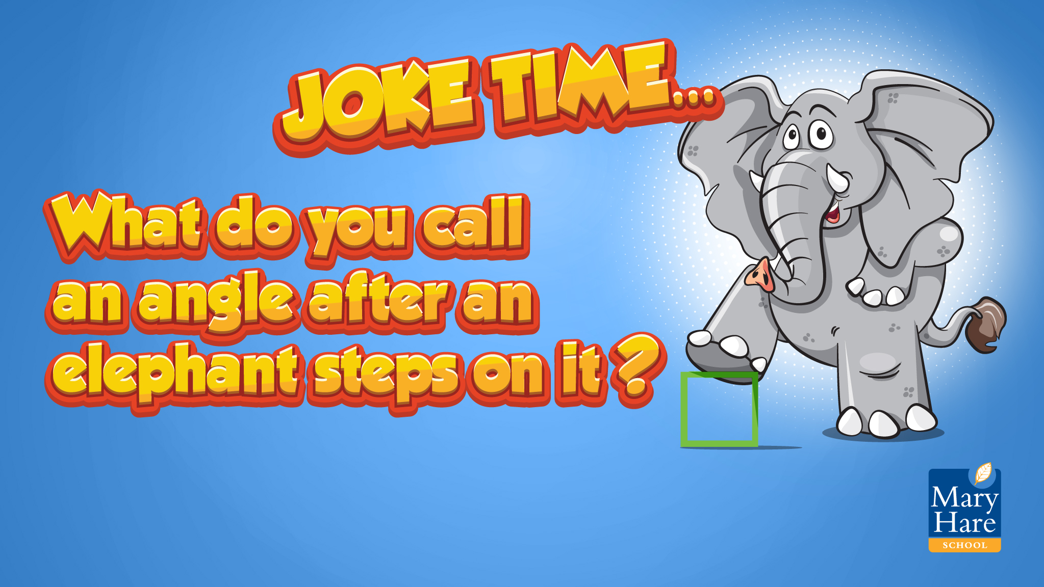
Notes:
Joke Time
Can students guess the punch line?

Slide 6
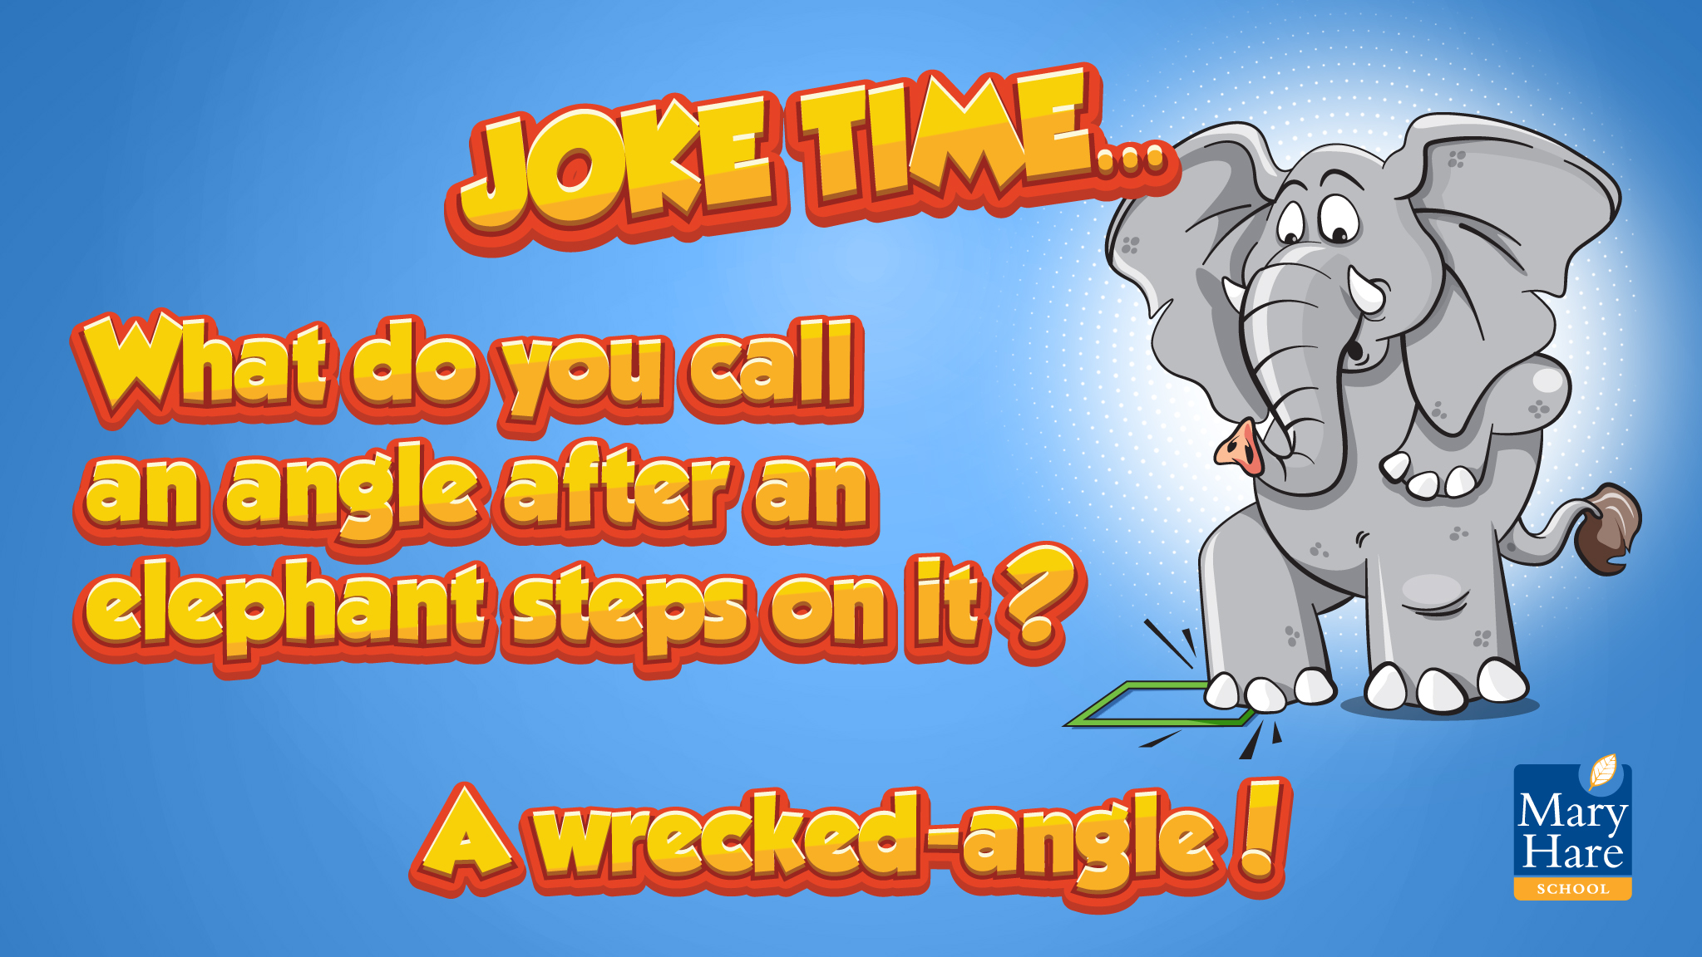
Notes:
Joke Time
Can students guess the punch line?

Slide 7
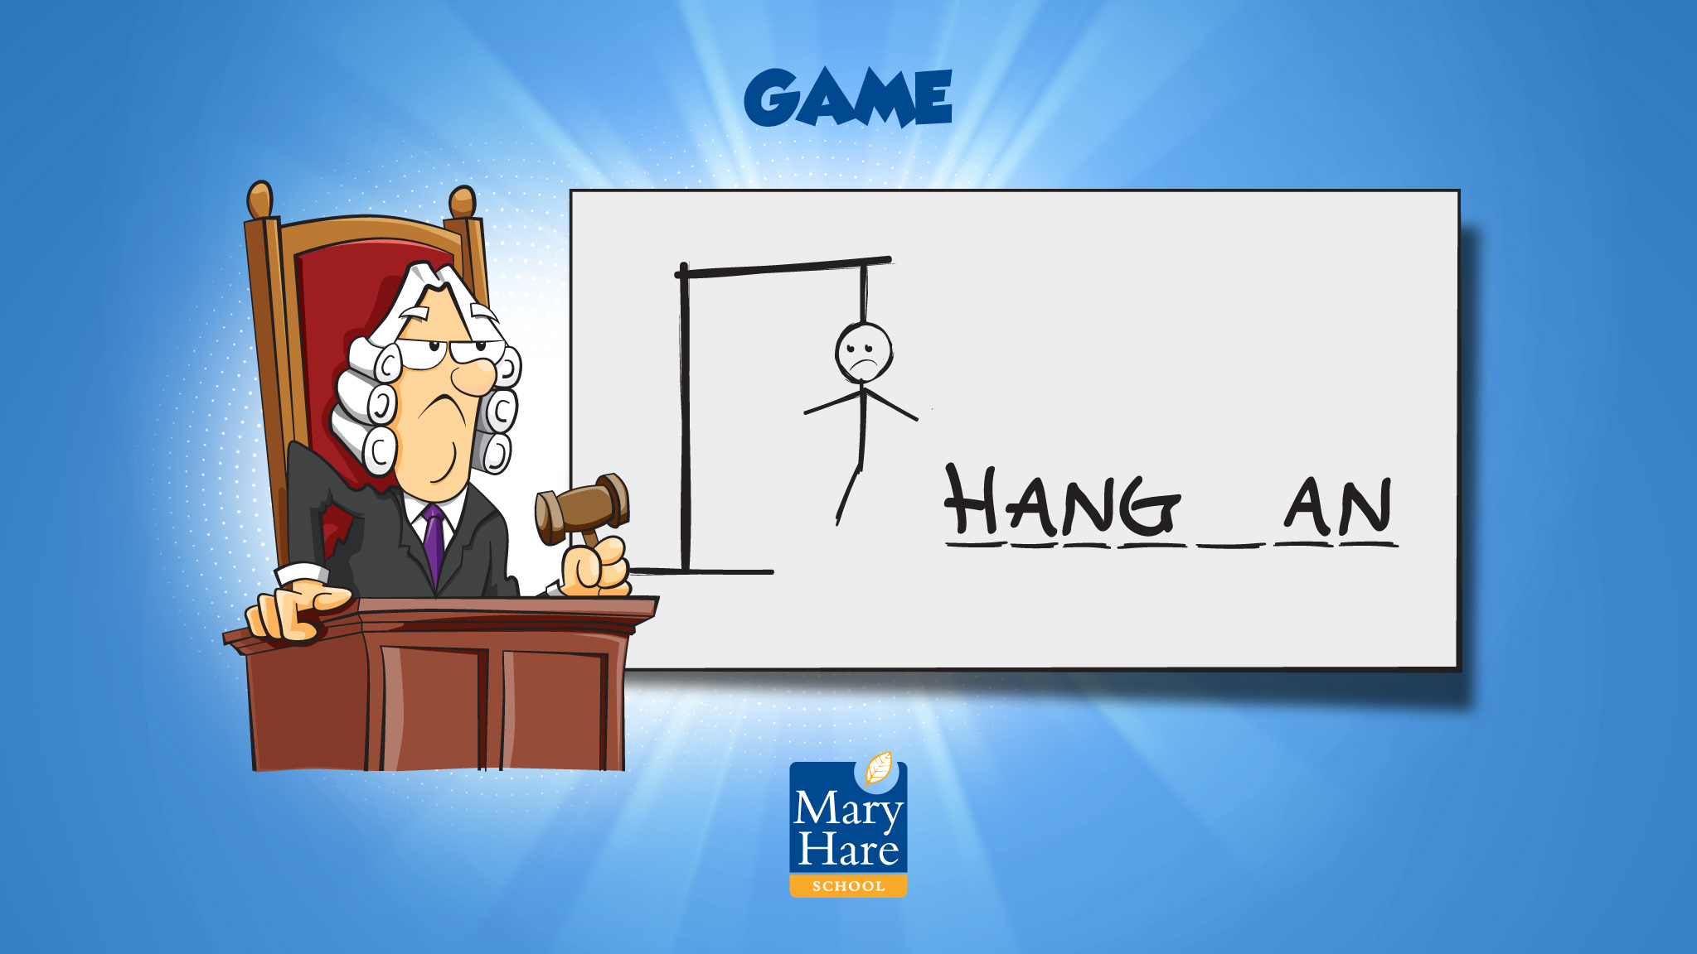
Notes:
Hangman
Put the student in charge with a word card (to support spellings). Include target words.
With a small group every student can take it in turns to guess a letter until the whole word is spelt. No shouting out. This encourages spelling.
With larger groups divide the class into teams. If students use their turn to guess the word they also have to be able to spell it.

