Slide 2
Notes:
Word Scramble
Unscramble the letters to find the topic word. You can remove the word bank to make it harder.

Slide 3
Notes:
Mathematically Speaking
An opportunity to link the topic with other subjects and the wider world.
Let the students lead the discussion. Look for opportunities to include target words.
Conversation ideas: Talk about Escher, look at other Escher pictures, symmetry, reflection, impossible pictures, optical illusions, tessellations.
When have you used angles in art? – perspective, 3D shapes, enlargements, proportion.
What other artists use angles and shapes?

Slide 4
Notes:
Bingo
Ask students to choose any 4 words to put on their bingo card (you can use mini white boards or paper)
When students see the picture that matches their word they can cross it off.
You could vary how many words the students choose.
You could provide the word/picture cards as a reference if needed.

Slide 5
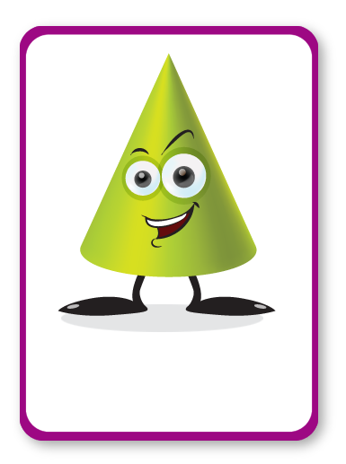
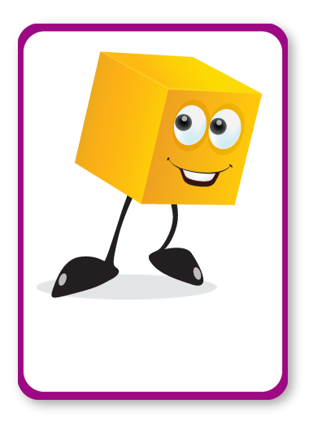
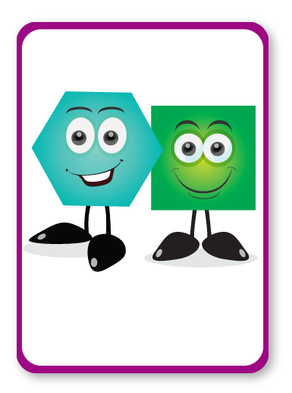
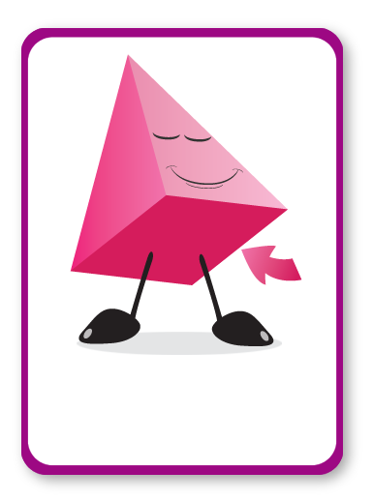
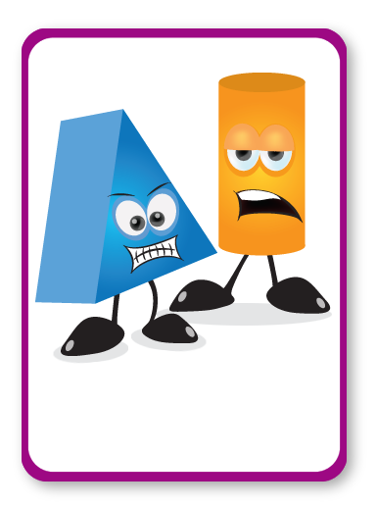
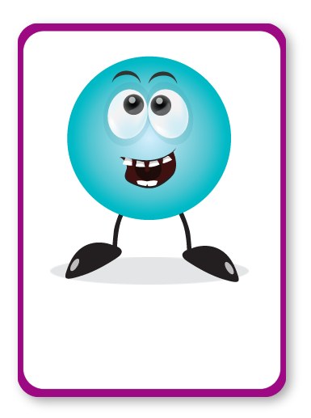
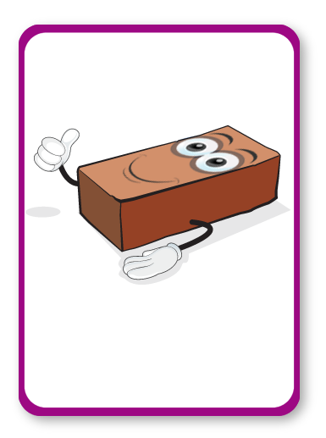
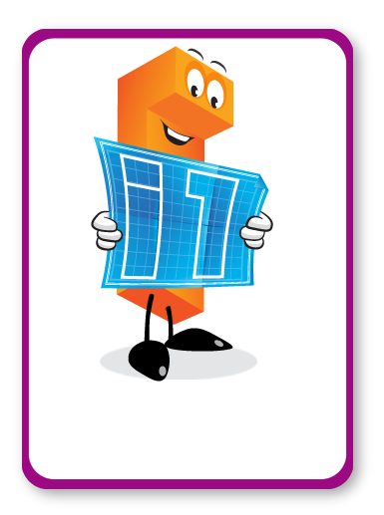
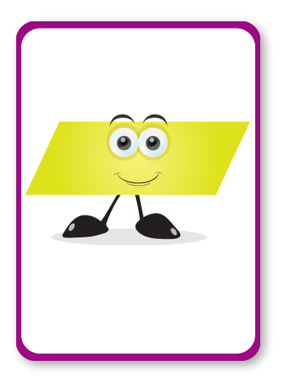
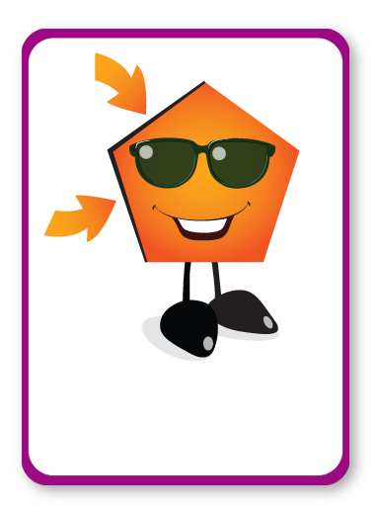
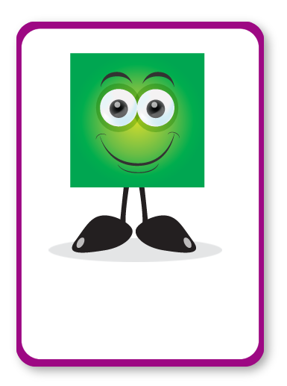
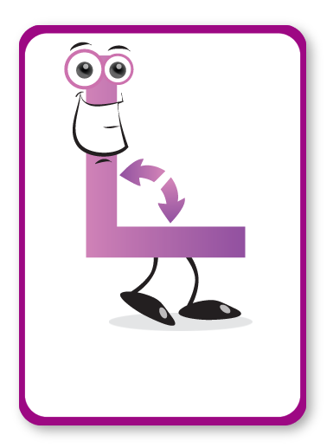
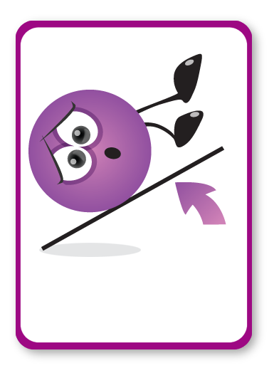
CONE
CUBE
POLYGON
BASE
TRAPEZIUM
PRISM
CIRCLE
SOLID
ELEVATION
PARALLELOGRAM
SIDE
SQUARE
RIGHT ANGLE
TRIANGLE
TANGENT
Notes:
Bingo
Ask students to choose any 4 words to put on their bingo card (you can use mini white boards or paper)
When students see the picture that matches their word they can cross it off.
You could vary how many words the students choose.
You could provide the word/picture cards as a reference if needed.

Slide 7
SOLID

Slide 9
TRIANGLE

Slide 11
TANGENT

Slide 13
SQUARE

Slide 15
RIGHT ANGLE

Slide 17
SIDE

Slide 19
CIRCLE

Slide 21
ELEVATION

Slide 23
CUBE

Slide 25
POLYGON

Slide 27
PARALLELOGRAM

Slide 29
PRISM

Slide 31
TRAPEZIUM

Slide 33
CONE

Slide 35
BASE

Slide 36
Notes:
Joke Time
Can students guess the punch line?

Slide 38
Notes:
Bleep
Students work in teams/pairs.
One student picks a word/picture card and then describes it using their knowledge of the word. Decide if you want them to use words, actions or pictures.
They cannot say the word on the card, but they could say bleep instead.
Their team/partner tries to guess the word. You may want to use a timer.
Opposing teams can gain points by listening and writing down other maths words that were used in the description or by challenging when the time runs out.

