Slide 2
Notes:
Word Scramble
Unscramble the letters to find the topic word. You can remove the word bank to make it harder.

Slide 3
Notes:
Mathematically Speaking
An opportunity to link the topic with other subjects and the wider world.
Let the students lead the discussion. Look for opportunities to include target words.
Conversation ideas: Name a business that has to produce estimates. Do any adults you know estimate at work?
Why is it important to be as accurate as possible? For higher students, talk about error intervals and upper and lower bounds.

Slide 4
Notes:
Bingo
Ask students to choose any 4 words to put on their bingo card (you can use mini white boards or paper)
When students see the picture that matches their word they can cross it off.
You could vary how many words the students choose.
You could provide the word/picture cards as a reference if needed.

Slide 5
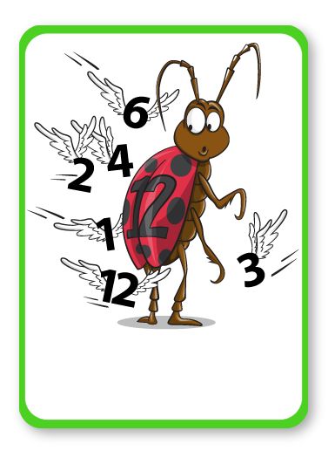
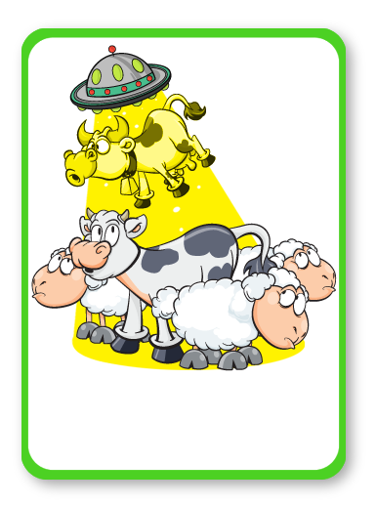
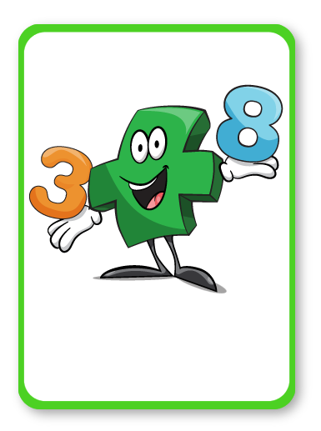
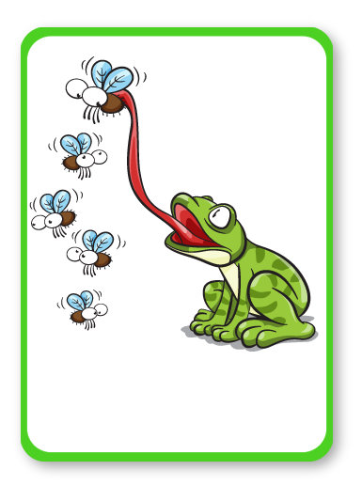
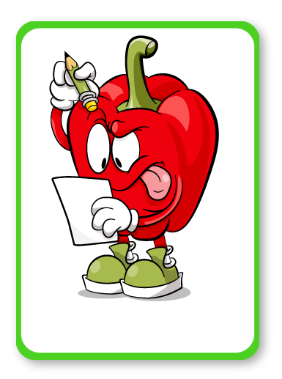
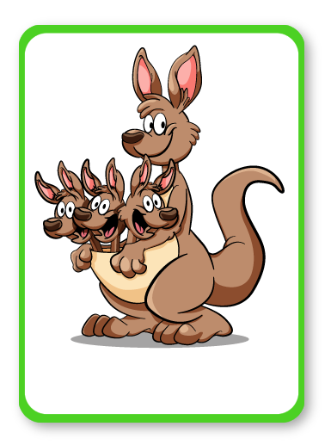
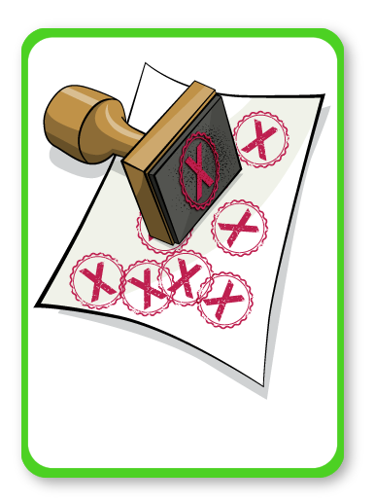
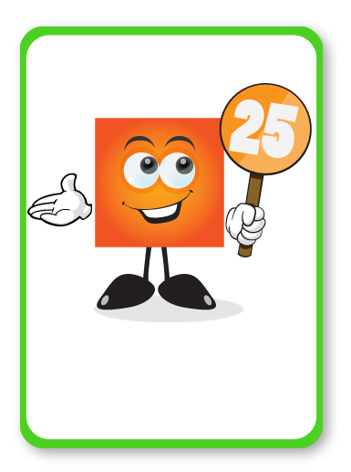
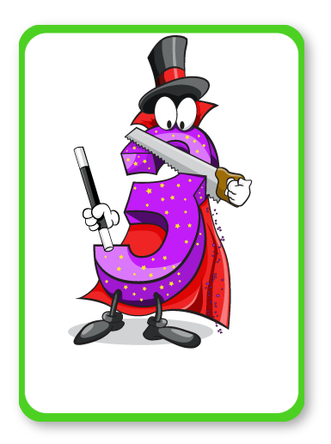
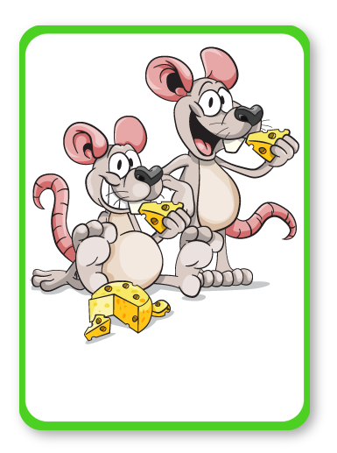
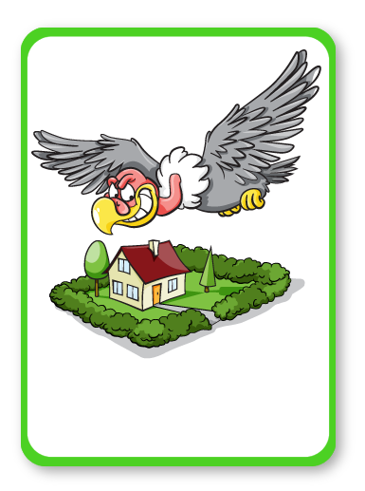
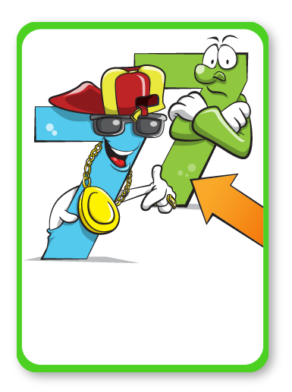
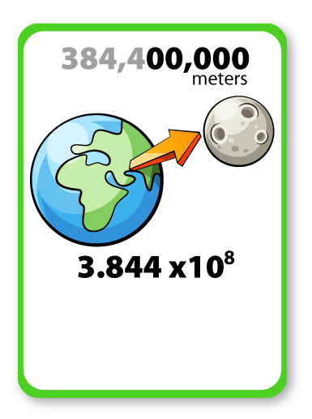
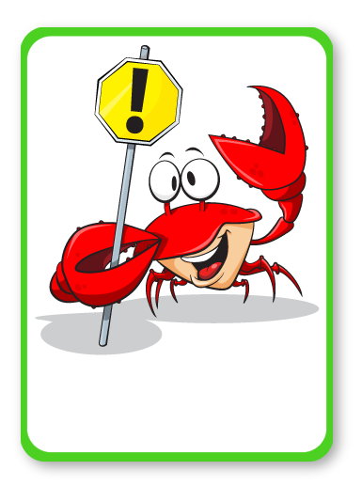
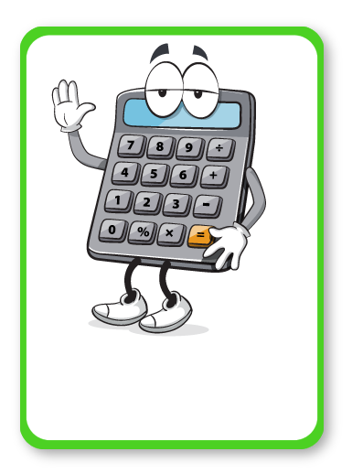
FACTORS
DIFFERENCE
TOTAL
UPPER
ESTIMATE
MULTIPLE
TIMES
SQUARE
PRIME
STANDARD FORM
SHARE
BOUND
ORDINARY
ERROR
CALCULATOR
Notes:
Bingo
Ask students to choose any 4 words to put on their bingo card (you can use mini white boards or paper)
When students see the picture that matches their word they can cross it off.
You could vary how many words the students choose.
You could provide the word/picture cards as a reference if needed.

Slide 7
CALCULATOR

Slide 9
ESTIMATE

Slide 11
DIFFERENCE

Slide 13
FACTORS

Slide 15
MULTIPLE

Slide 17
ORDINARY

Slide 19
TIMES

Slide 21
PRIME

Slide 23
SHARE

Slide 25
SQUARE

Slide 27
STANDARD FORM

Slide 29
TOTAL

Slide 31
UPPER

Slide 33
ERROR

Slide 35
BOUND

Slide 36
Notes:
Joke Time
Can students guess the punch line?

Slide 38
Notes:
Bleep
Students work in teams/pairs.
One student picks a word/picture card and then describes it using their knowledge of the word. Decide if you want them to use words, actions or pictures.
They cannot say the word on the card, but they could say bleep instead.
Their team/partner tries to guess the word. You may want to use a timer.
Opposing teams can gain points by listening and writing down other maths words that were used in the description or by challenging when the time runs out.

