Slide 1


Slide 2

Notes:
Cold test
The vocabulary topic test is completed at the beginning of the intervention which will give a baseline and generate target words.
Students need to complete the missing word. They are given the first letter.
Give the full test or choose how many words to assess based on students needs/ability, e.g. just the first five words.
Apply students’ normal way of working, e.g. you can read the questions to the student.
When marking, allow 2 marks for a fully correct answer, 1 mark if the intention of the word is correct but there is a spelling or word variation error (e.g. day instead of days), 0 if wrong or blank. You will use the results from this to inform the Word Wizard activity.
Do not go through this assessment with the students after to avoid them becoming over familiar with the questions. Use the results to inform the words you focus on in the following lessons.​

Slide 3

Notes:
Mathematically Speaking
An opportunity to link the topic with other subjects and the wider world.
Let the students lead the discussion. Look for opportunities to include target words.
Conversation ideas: What is this? Till/cash desk/cash drawer/cash register/money box/
Where else can you keep money?
Tills calculate the total for us, like calculators
Name a job where you would use a till. What other Maths skills are involved? Estimating to check totals, sharing the bill, calculating the difference for a customers change

Slide 4

Notes:
Kim’s Game
This activity is designed to introduce each topic word. It will also start the process of committing them to memory.
To play the game memorise where the words are. One will be removed. Which one has gone?
12 of the 15 words have been included. Upper, calculator and prime are not included.
You can edit this PowerPoint to change the words that you want to include.

Slide 5


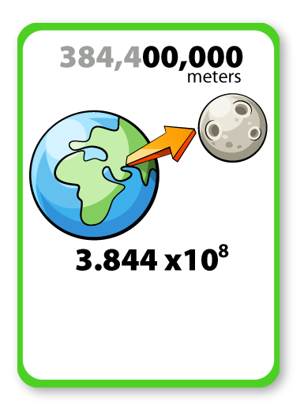

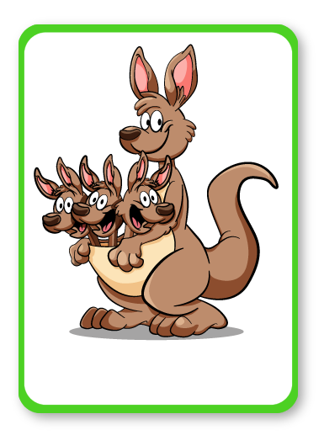

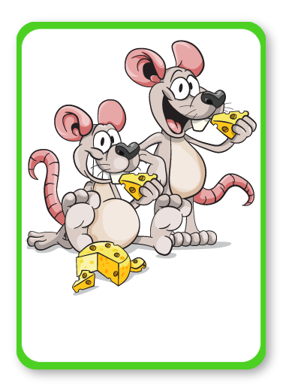


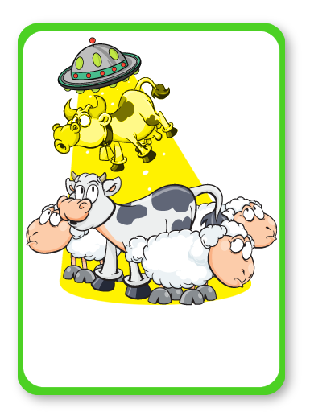

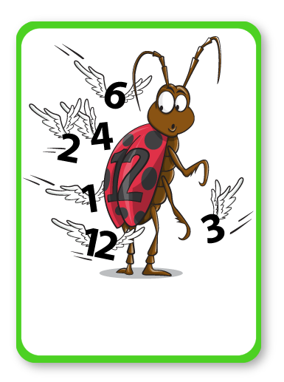


STANDARD FORM
TOTAL
SQUARE
MULTIPLE
ESTIMATE
SHARE
Ordinary
ERROR
DIFFERENCE
BOUND
FACTORS
TIMES
Notes:
Kim’s Game
Spend time discussing the pictures and words.
Why do you think this picture represents the word?
Look at definitions, pronunciation, spelling, links to Maths and other subjects, synonyms, antonyms, word variations, words with the same root etc.

Slide 6

STANDARD FORM
TOTAL
SQUARE
MULTIPLE
ESTIMATE
SHARE
Ordinary
ERROR
DIFFERENCE
BOUND
FACTORS
Notes:
Kim’s Game
Spend time discussing the pictures and words.
Why do you think this picture represents the word?
Look at definitions, pronunciation, spelling, links to Maths and other subjects, synonyms, antonyms, word variations, words with the same root etc.

Slide 7
STANDARD FORM
TOTAL
SQUARE
MULTIPLE
ESTIMATE
SHARE
Ordinary
ERROR
DIFFERENCE
BOUND
FACTORS
TIMES
Notes:
Kim’s Game
Spend time discussing the pictures and words.
Why do you think this picture represents the word?
Look at definitions, pronunciation, spelling, links to Maths and other subjects, synonyms, antonyms, word variations, words with the same root etc.

Slide 8
STANDARD FORM
TOTAL
MULTIPLE
ESTIMATE
SHARE
Ordinary
ERROR
DIFFERENCE
BOUND
FACTORS
TIMES
Notes:
Kim’s Game
Spend time discussing the pictures and words.
Why do you think this picture represents the word?
Look at definitions, pronunciation, spelling, links to Maths and other subjects, synonyms, antonyms, word variations, words with the same root etc.

Slide 9
STANDARD FORM
TOTAL
SQUARE
MULTIPLE
ESTIMATE
SHARE
Ordinary
ERROR
DIFFERENCE
BOUND
FACTORS
TIMES
Notes:
Kim’s Game
Spend time discussing the pictures and words.
Why do you think this picture represents the word?
Look at definitions, pronunciation, spelling, links to Maths and other subjects, synonyms, antonyms, word variations, words with the same root etc.

Slide 10
STANDARD FORM
SQUARE
MULTIPLE
ESTIMATE
SHARE
Ordinary
ERROR
DIFFERENCE
BOUND
FACTORS
TIMES
Notes:
Kim’s Game
Spend time discussing the pictures and words.
Why do you think this picture represents the word?
Look at definitions, pronunciation, spelling, links to Maths and other subjects, synonyms, antonyms, word variations, words with the same root etc.

Slide 11
STANDARD FORM
TOTAL
SQUARE
MULTIPLE
ESTIMATE
SHARE
Ordinary
ERROR
DIFFERENCE
BOUND
FACTORS
TIMES
Notes:
Kim’s Game
Spend time discussing the pictures and words.
Why do you think this picture represents the word?
Look at definitions, pronunciation, spelling, links to Maths and other subjects, synonyms, antonyms, word variations, words with the same root etc.

Slide 12
STANDARD FORM
TOTAL
SQUARE
MULTIPLE
ESTIMATE
SHARE
Ordinary
ERROR
BOUND
FACTORS
TIMES
Notes:
Kim’s Game
Spend time discussing the pictures and words.
Why do you think this picture represents the word?
Look at definitions, pronunciation, spelling, links to Maths and other subjects, synonyms, antonyms, word variations, words with the same root etc.

Slide 13
STANDARD FORM
TOTAL
SQUARE
MULTIPLE
ESTIMATE
SHARE
Ordinary
ERROR
DIFFERENCE
BOUND
FACTORS
TIMES
Notes:
Kim’s Game
Spend time discussing the pictures and words.
Why do you think this picture represents the word?
Look at definitions, pronunciation, spelling, links to Maths and other subjects, synonyms, antonyms, word variations, words with the same root etc.

Slide 14
STANDARD FORM
TOTAL
SQUARE
MULTIPLE
ESTIMATE
SHARE
ERROR
DIFFERENCE
BOUND
FACTORS
TIMES
Notes:
Kim’s Game
Spend time discussing the pictures and words.
Why do you think this picture represents the word?
Look at definitions, pronunciation, spelling, links to Maths and other subjects, synonyms, antonyms, word variations, words with the same root etc.

Slide 15
STANDARD FORM
TOTAL
SQUARE
MULTIPLE
ESTIMATE
SHARE
Ordinary
ERROR
DIFFERENCE
BOUND
FACTORS
TIMES
Notes:
Kim’s Game
Spend time discussing the pictures and words.
Why do you think this picture represents the word?
Look at definitions, pronunciation, spelling, links to Maths and other subjects, synonyms, antonyms, word variations, words with the same root etc.

Slide 16
TOTAL
SQUARE
MULTIPLE
ESTIMATE
SHARE
Ordinary
ERROR
DIFFERENCE
BOUND
FACTORS
TIMES
Notes:
Kim’s Game
Spend time discussing the pictures and words.
Why do you think this picture represents the word?
Look at definitions, pronunciation, spelling, links to Maths and other subjects, synonyms, antonyms, word variations, words with the same root etc.

Slide 17
STANDARD FORM
TOTAL
SQUARE
MULTIPLE
ESTIMATE
SHARE
Ordinary
ERROR
DIFFERENCE
BOUND
FACTORS
TIMES
Notes:
Kim’s Game
Spend time discussing the pictures and words.
Why do you think this picture represents the word?
Look at definitions, pronunciation, spelling, links to Maths and other subjects, synonyms, antonyms, word variations, words with the same root etc.

Slide 18
STANDARD FORM
TOTAL
SQUARE
MULTIPLE
ESTIMATE
SHARE
Ordinary
DIFFERENCE
BOUND
FACTORS
TIMES
Notes:
Kim’s Game
Spend time discussing the pictures and words.
Why do you think this picture represents the word?
Look at definitions, pronunciation, spelling, links to Maths and other subjects, synonyms, antonyms, word variations, words with the same root etc.

Slide 19
STANDARD FORM
TOTAL
SQUARE
MULTIPLE
ESTIMATE
SHARE
Ordinary
ERROR
DIFFERENCE
BOUND
FACTORS
TIMES
Notes:
Kim’s Game
Spend time discussing the pictures and words.
Why do you think this picture represents the word?
Look at definitions, pronunciation, spelling, links to Maths and other subjects, synonyms, antonyms, word variations, words with the same root etc.

Slide 20
STANDARD FORM
TOTAL
SQUARE
MULTIPLE
ESTIMATE
Ordinary
ERROR
DIFFERENCE
BOUND
FACTORS
TIMES
Notes:
Kim’s Game
Spend time discussing the pictures and words.
Why do you think this picture represents the word?
Look at definitions, pronunciation, spelling, links to Maths and other subjects, synonyms, antonyms, word variations, words with the same root etc.

Slide 21
STANDARD FORM
TOTAL
SQUARE
MULTIPLE
ESTIMATE
SHARE
Ordinary
ERROR
DIFFERENCE
BOUND
FACTORS
TIMES
Notes:
Kim’s Game
Spend time discussing the pictures and words.
Why do you think this picture represents the word?
Look at definitions, pronunciation, spelling, links to Maths and other subjects, synonyms, antonyms, word variations, words with the same root etc.

Slide 22
STANDARD FORM
TOTAL
SQUARE
MULTIPLE
ESTIMATE
SHARE
Ordinary
ERROR
DIFFERENCE
FACTORS
TIMES
Notes:
Kim’s Game
Spend time discussing the pictures and words.
Why do you think this picture represents the word?
Look at definitions, pronunciation, spelling, links to Maths and other subjects, synonyms, antonyms, word variations, words with the same root etc.

Slide 23
STANDARD FORM
TOTAL
SQUARE
MULTIPLE
ESTIMATE
SHARE
Ordinary
ERROR
DIFFERENCE
BOUND
FACTORS
TIMES
Notes:
Kim’s Game
Spend time discussing the pictures and words.
Why do you think this picture represents the word?
Look at definitions, pronunciation, spelling, links to Maths and other subjects, synonyms, antonyms, word variations, words with the same root etc.

Slide 24
STANDARD FORM
TOTAL
SQUARE
MULTIPLE
ESTIMATE
SHARE
Ordinary
ERROR
DIFFERENCE
BOUND
TIMES
Notes:
Kim’s Game
Spend time discussing the pictures and words.
Why do you think this picture represents the word?
Look at definitions, pronunciation, spelling, links to Maths and other subjects, synonyms, antonyms, word variations, words with the same root etc.

Slide 25
STANDARD FORM
TOTAL
SQUARE
MULTIPLE
ESTIMATE
SHARE
Ordinary
ERROR
DIFFERENCE
BOUND
FACTORS
TIMES
Notes:
Kim’s Game
Spend time discussing the pictures and words.
Why do you think this picture represents the word?
Look at definitions, pronunciation, spelling, links to Maths and other subjects, synonyms, antonyms, word variations, words with the same root etc.

Slide 26
STANDARD FORM
TOTAL
SQUARE
MULTIPLE
SHARE
Ordinary
ERROR
DIFFERENCE
BOUND
FACTORS
TIMES
Notes:
Kim’s Game
Spend time discussing the pictures and words.
Why do you think this picture represents the word?
Look at definitions, pronunciation, spelling, links to Maths and other subjects, synonyms, antonyms, word variations, words with the same root etc.

Slide 27
STANDARD FORM
TOTAL
SQUARE
MULTIPLE
ESTIMATE
SHARE
Ordinary
ERROR
DIFFERENCE
BOUND
FACTORS
TIMES
Notes:
Kim’s Game
Spend time discussing the pictures and words.
Why do you think this picture represents the word?
Look at definitions, pronunciation, spelling, links to Maths and other subjects, synonyms, antonyms, word variations, words with the same root etc.

Slide 28
STANDARD FORM
TOTAL
SQUARE
ESTIMATE
SHARE
Ordinary
ERROR
DIFFERENCE
BOUND
FACTORS
TIMES
Notes:
Kim’s Game
Spend time discussing the pictures and words.
Why do you think this picture represents the word?
Look at definitions, pronunciation, spelling, links to Maths and other subjects, synonyms, antonyms, word variations, words with the same root etc.

Slide 29
STANDARD FORM
TOTAL
SQUARE
MULTIPLE
ESTIMATE
SHARE
Ordinary
ERROR
DIFFERENCE
BOUND
FACTORS
TIMES
Notes:
Kim’s Game
Spend time discussing the pictures and words.
Why do you think this picture represents the word?
Look at definitions, pronunciation, spelling, links to Maths and other subjects, synonyms, antonyms, word variations, words with the same root etc.

Slide 30

Notes:
Can students guess the punch line?

Slide 31


Slide 32

Notes:
I went to the market…
Working in small groups, a student names one of the topic words e.g. triangle, the next student has to repeat their word and name another e.g. estimate, multiple.
Continue for as long as the memory will allow!
You may want to display the words from Kim’s game to support the students.

