Slide 1
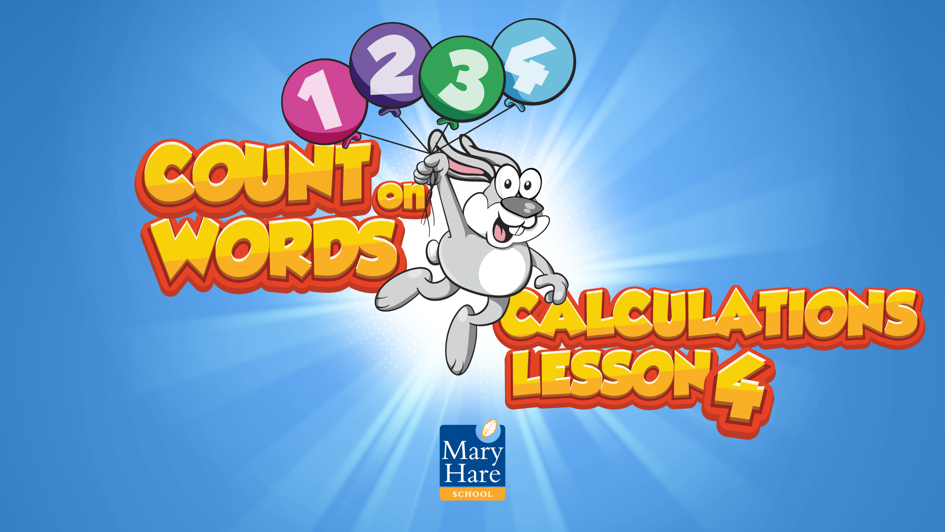

Slide 2
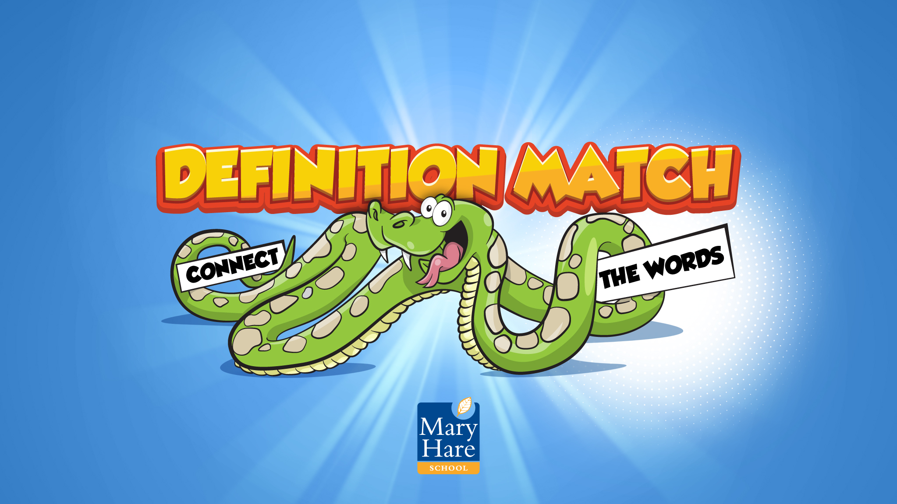
Notes:
Definition Match
Draw a line between the word and the matching definition.

Slide 3
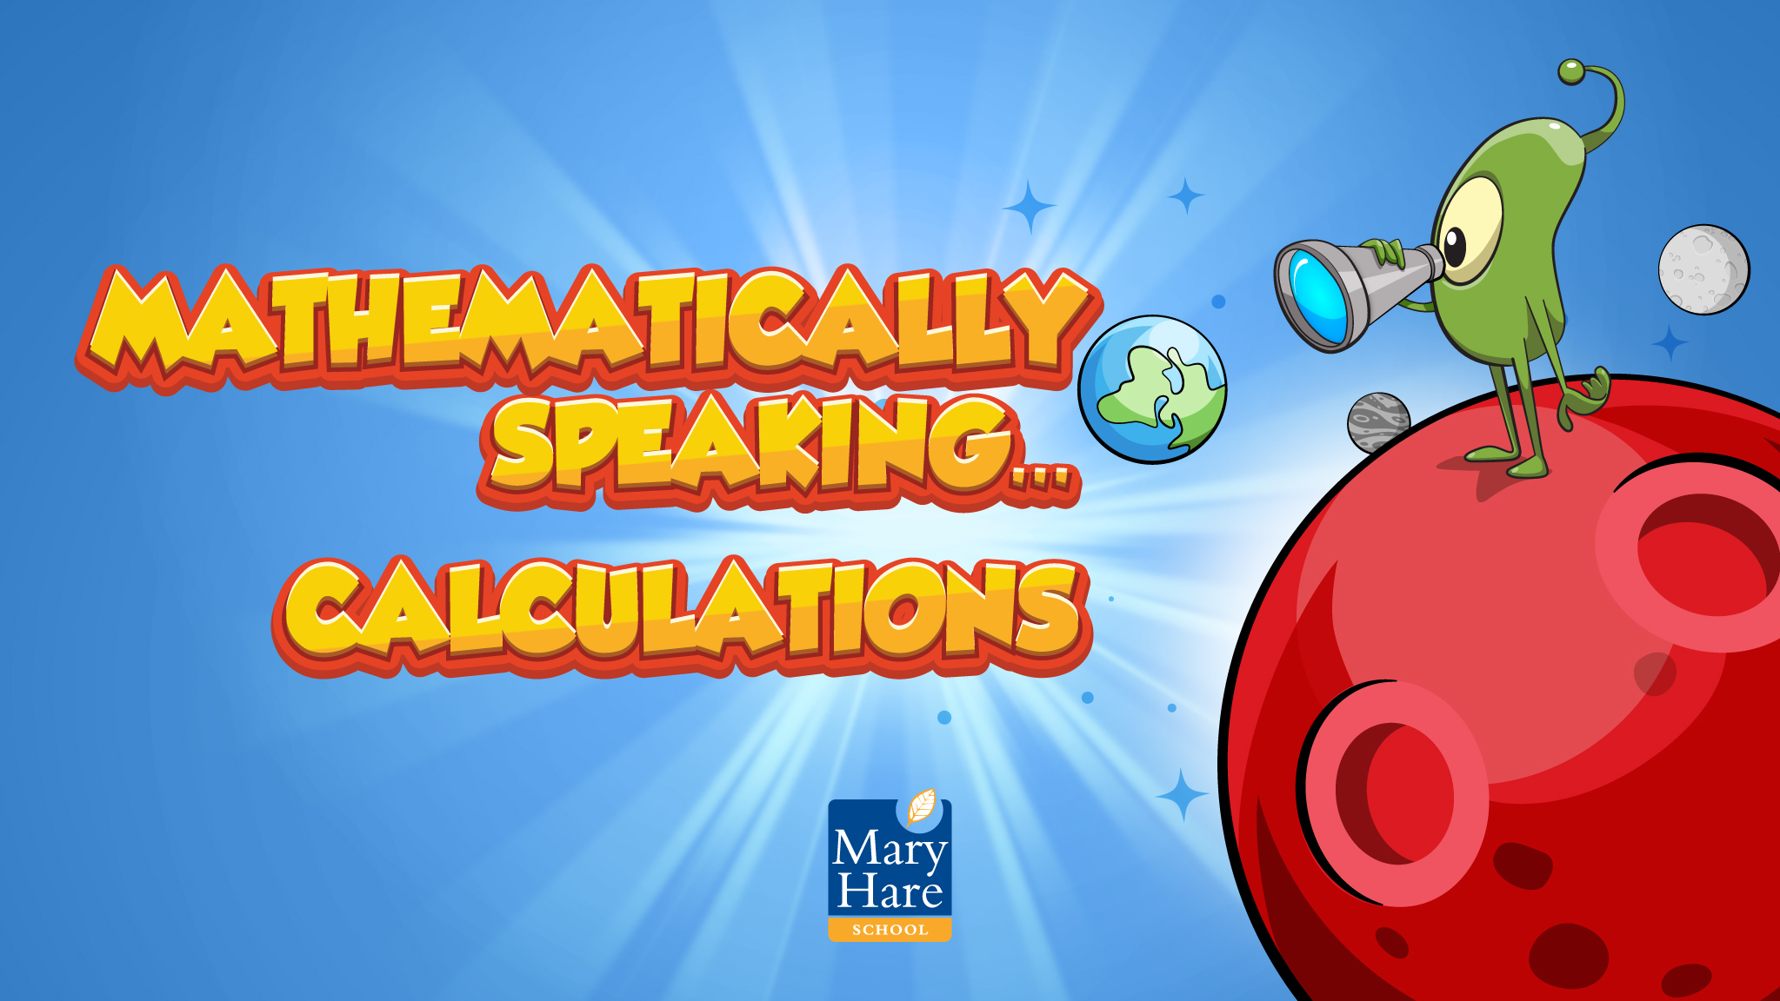
Notes:
Mathematically Speaking
An opportunity to link the topic with other subjects and the wider world.
Let the students lead the discussion. Look for opportunities to include target words.
Conversation ideas: When do we need to use very large/small numbers?
The alien is looking at Earth from Mars. Try and estimate what the distance is? (answer 2.49 x 10^⁸miles)
We use ordinary numbers and standard form to help write these numbers more easily.
What are the advantages/disadvantages of writing numbers this way?

Slide 4
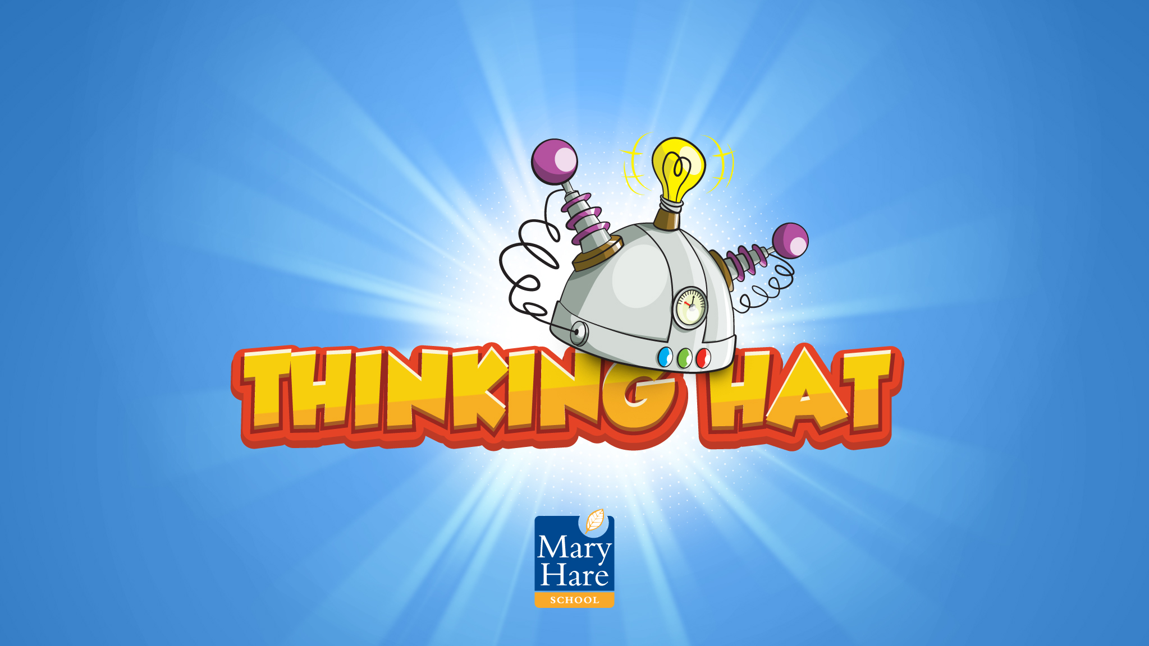
Notes:
Thinking Hat
What word am I thinking of?
The adult or student can be thinking of a word (or pick a word card) and the others need to ask questions to find out what the word is.
You could change this by limiting it to questions with a yes or no answer and by limiting the number of questions you can ask.

Slide 5
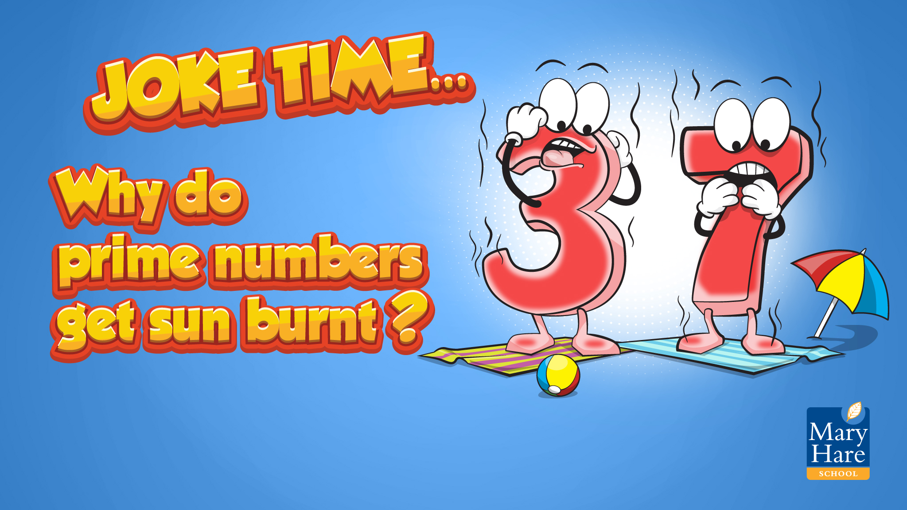
Notes:
Joke Time
Can students guess the punch line?

Slide 6
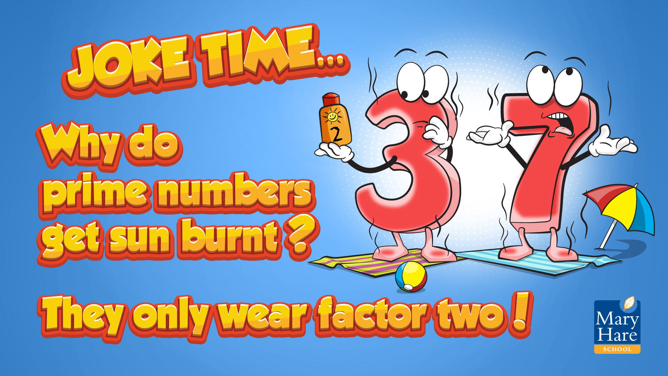
Notes:
Can students guess the punch line?

Slide 7
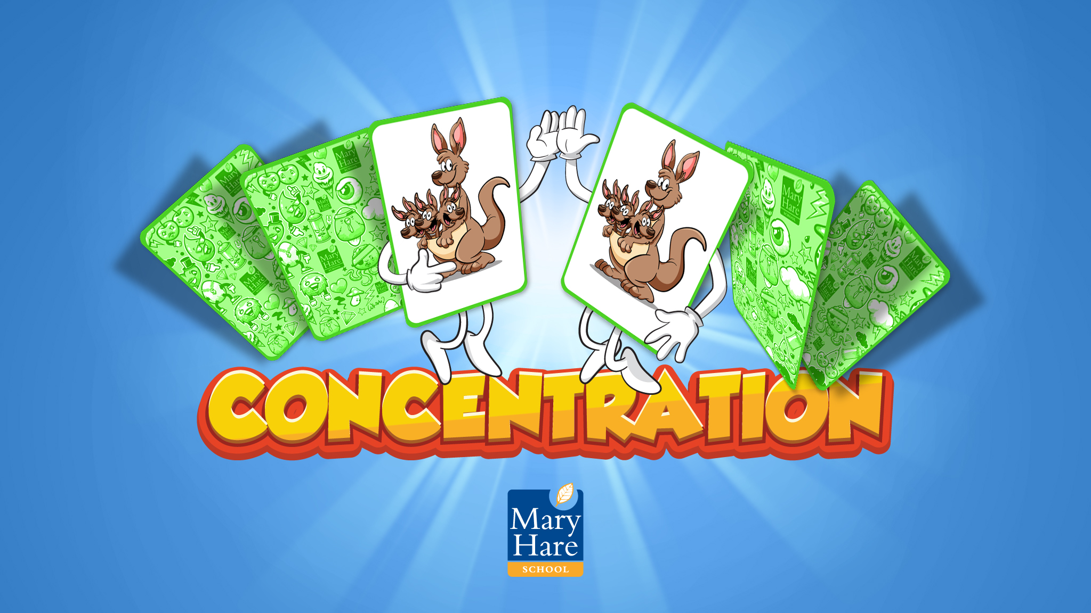
Notes:
Concentration
Work individually or in pairs/small groups.
First get students to match the picture card to the word card. Take away the unmatched cards.
Shuffle the cards you have left then turn them face down. Students take it in turns to find the matching pairs (word and picture).
If they find a pair they can have another go. The winner is the person to find the most pairs.
Students have to concentrate to remember where all the different cards are.

