Slide 2
Notes:
Word Scramble
Unscramble the letters to find the topic word. You can remove the word bank to make it harder.

Slide 3
Notes:
Mathematically Speaking
An opportunity to link the topic with other subjects and the wider world.
Let the students lead the discussion. Look for opportunities to include target words.
Conversation ideas: talk about spending money/pocket money/allowance
Ask students what they spend their money on, are they saving for anything?
Do they know about savings accounts and interest rates?

Slide 4
Notes:
Bingo
Ask students to choose any 4 words to put on their bingo card (you can use mini white boards or paper)
When students see the picture that matches their word they can cross it off.
You could vary how many words the students choose.
You could provide the word/picture cards as a reference if needed.

Slide 5
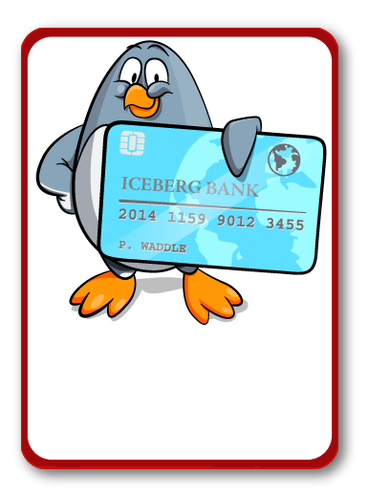
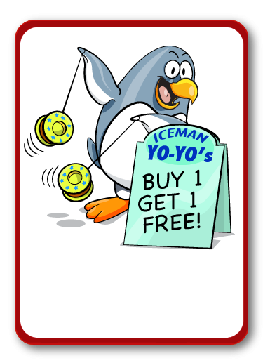
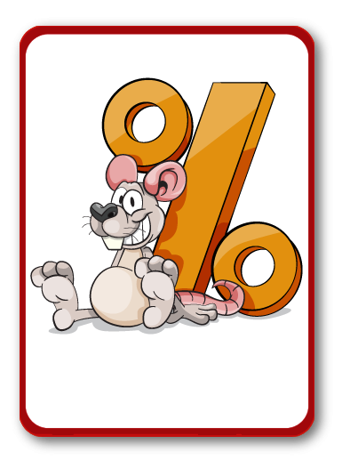
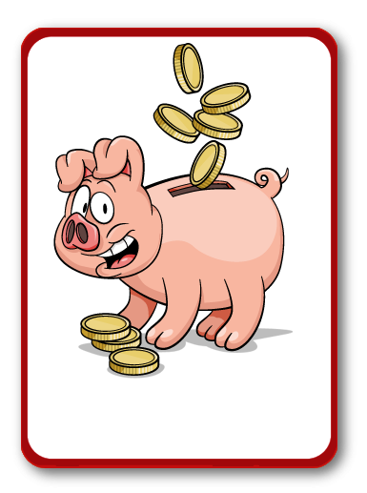
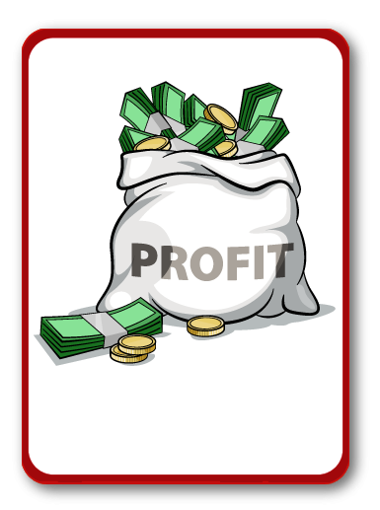
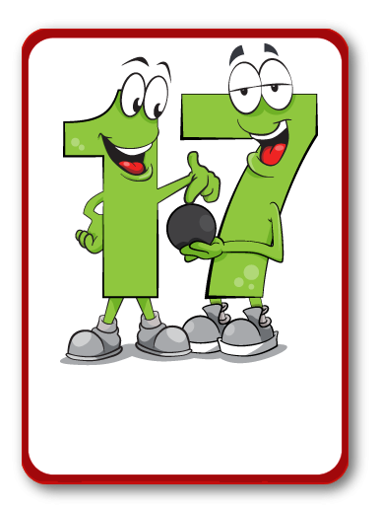
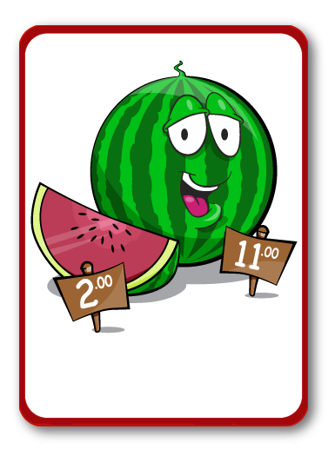
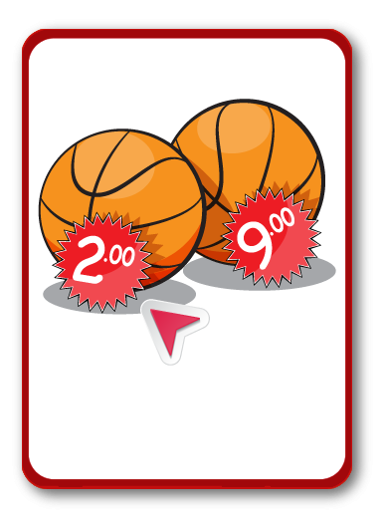
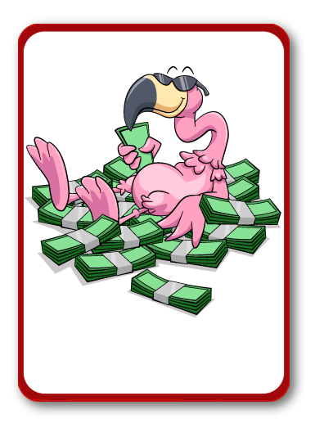
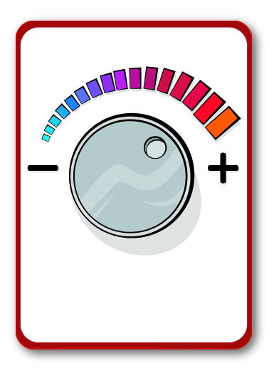
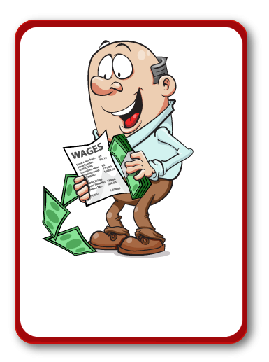
Bank account
SPECIAL
OFFER
PERCENTAGE
SAVE
PROFIT
DECIMAL POINT
CHEAPER
PRICE
MONEY
SELL
INTEREST RATE
AMOUNT
SPEND
INCREASE
EARNINGS
Notes:
Bingo
Ask students to choose any 4 words to put on their bingo card (you can use mini white boards or paper)
When students see the picture that matches their word they can cross it off.
You could vary how many words the students choose.
You could provide the word/picture cards as a reference if needed.

Slide 7
EARNINGS

Slide 9
MONEY

Slide 11
SAVE

Slide 13
CHEAPER

Slide 15
PERCENTAGE

Slide 17
SPECIAL
OFFER

Slide 19
SELL

Slide 21
AMOUNT

Slide 23
INTEREST RATE

Slide 25
SPEND

Slide 27
INCREASE

Slide 29
PROFIT

Slide 31
PRICE

Slide 33
DECIMAL POINT

Slide 35
Bank account

Slide 36
Notes:
Joke Time
Can students guess the punch line?

Slide 38
Notes:
Bleep
Students work in teams/pairs.
One student picks a word/picture card and then describes it using their knowledge of the word. Decide if you want them to use words, actions or pictures.
They cannot say the word on the card, but they could say bleep instead.
Their team/partner tries to guess the word. You may want to use a timer.
Opposing teams can gain points by listening and writing down other maths words that were used in the description or by challenging when the time runs out.

