Slide 2
Notes:
Blank Page
Start with the topic title and get students to generate as many words as they can. All word forms and words linked to the key words can be included.
Give small groups a piece of paper and a different coloured pen each to encourage every child to contribute.

Slide 3
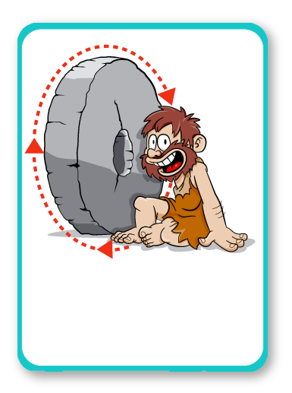
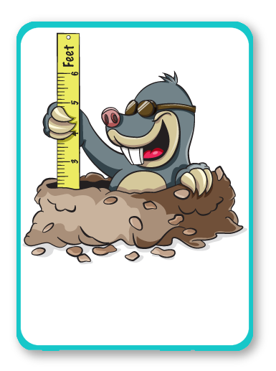
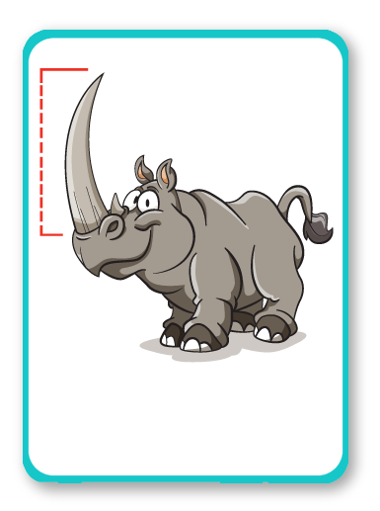
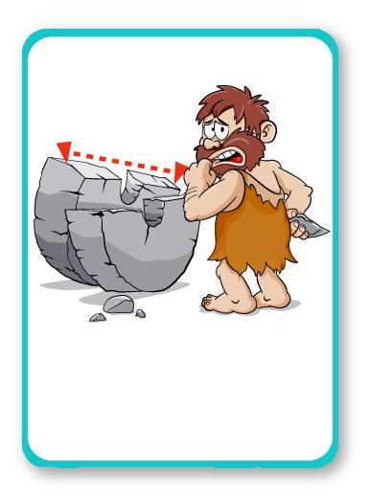
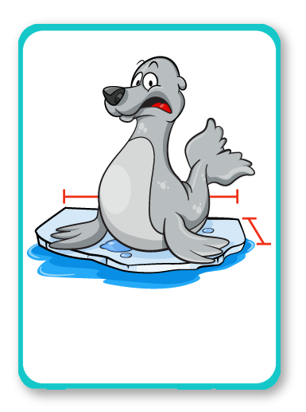
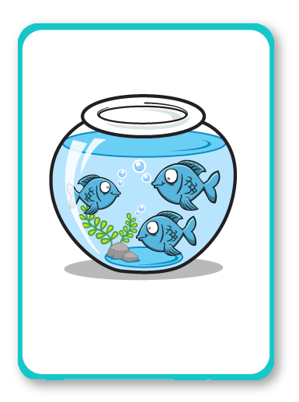
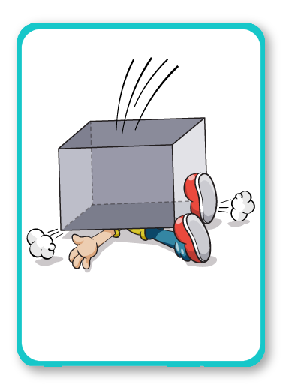
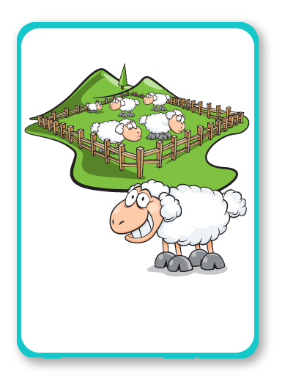
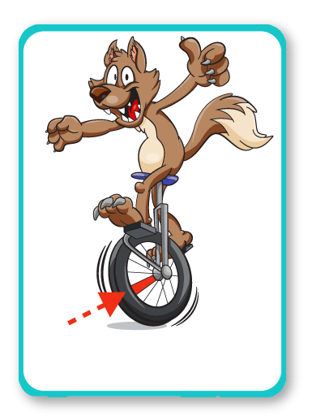
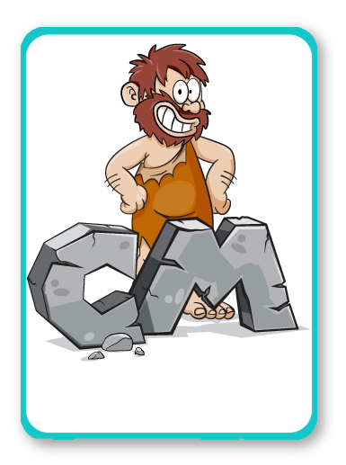
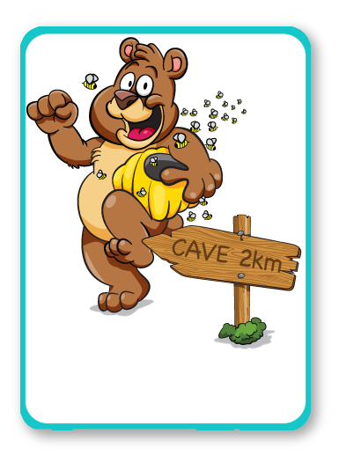
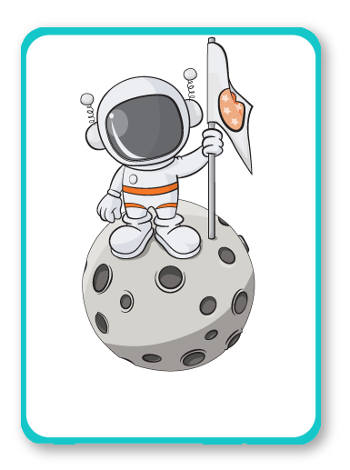
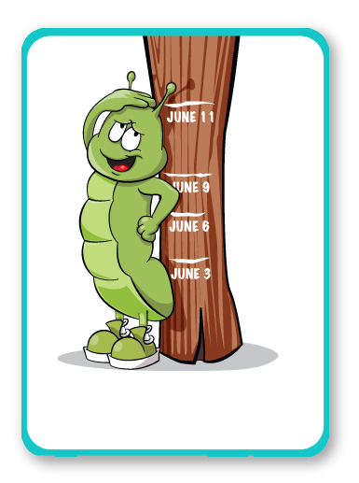
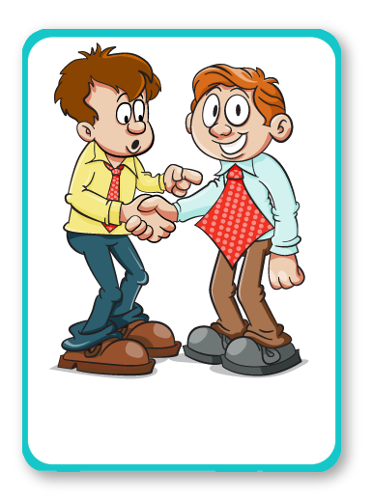
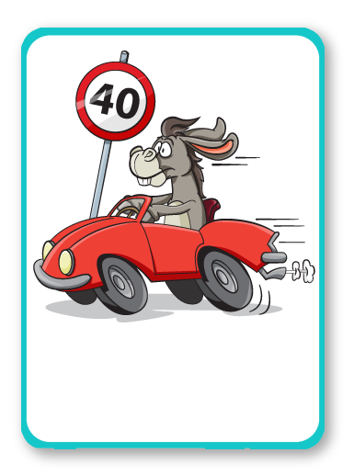
CIRCUMFERENCE
MEASUREMENT
LENGTH
DIAMETER
VOLUME
CUBOID
AREA
PERIMETER
RADIUS
CENTIMETRE
DISTANCE
SURFACE AREA
HEIGHT
WIDTH
KM/METRE
Notes:
Blank Page
How many words did the students remember?

Slide 4
Notes:
Mathematically Speaking
An opportunity to link the topic with other subjects and the wider world.
Let the students lead the discussion. Look for opportunities to include target words.
Conversation ideas: Estimate what distances are represented on the map, discuss different units. Have you ever used a map? Think about how google maps works on a phone.

Slide 5
Notes:
Last One Standing
In small groups, students take it in turns to say a new word. Allow all variations of the word to count separately e.g. month, months and monthly.
Allow other words from the topic as well as the 15 key words. You may want to write down their words to avoid any arguments.
Students sit down when they can’t think of a word or duplicate a word. You could allow them back in if they can think of a word the next time it’s their turn.
If working with one or two students, you could give them one minute to list as many words as possible.

Slide 6
Notes:
Can students guess the punch line?

Slide 7
Notes:
Can students guess the punch line?

Slide 8
Notes:
Hot test
The vocabulary assessment is completed again at the end of the 5 lessons. This will show if the students have made any progress.
You can go through this with them after marking.
Students need to complete the missing word. They are given the first letter.
Give the full test or choose how many words to assess based on students needs/ability, e.g. just the first five words.
Apply students’ normal way of working, e.g. you can read the questions to the student.
When marking, allow 2 marks for a fully correct answer, 1 mark if the intention of the word is correct but there is a spelling or word variation error (e.g. day instead of days)

