Slide 2
Notes:
Word Scramble
Unscramble the letters to find the topic word. You can remove the word bank to make it harder.

Slide 3
Notes:
Mathematically Speaking
An opportunity to link the topic with other subjects and the wider world.
Let the students lead the discussion. Look for opportunities to include target words.
Conversation ideas: Ask students what they think before revealing the answer.
How could you represent this information? What chart could you use?

Slide 4
Notes:
Mathematically Speaking
An opportunity to link the topic with other subjects and the wider world.
Let the students lead the discussion. Look for opportunities to include target words.
Conversation ideas: Ask students what they think before revealing the answer.
How could you represent this information? What chart could you use?

Slide 5
Notes:
Bingo
Ask students to choose any 4 words to put on their bingo card (you can use mini white boards or paper)
When students see the picture that matches their word they can cross it off.
You could vary how many words the students choose.
You could provide the word/picture cards as a reference if needed.

Slide 6
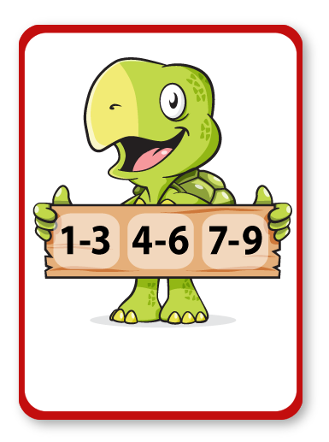
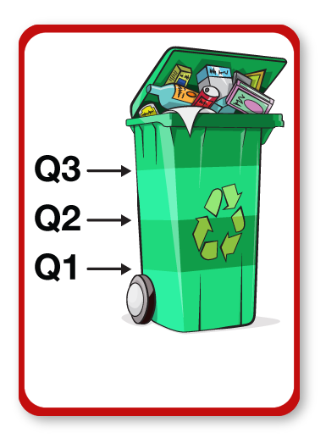
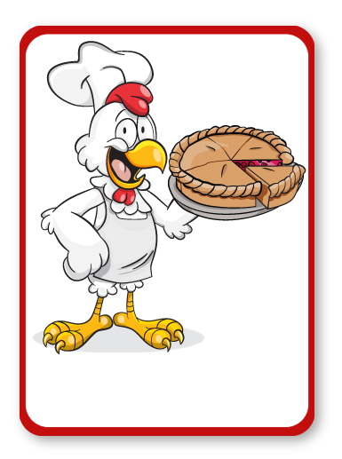
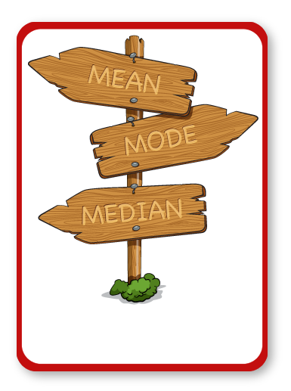
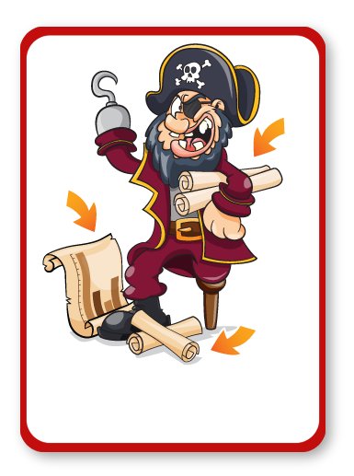
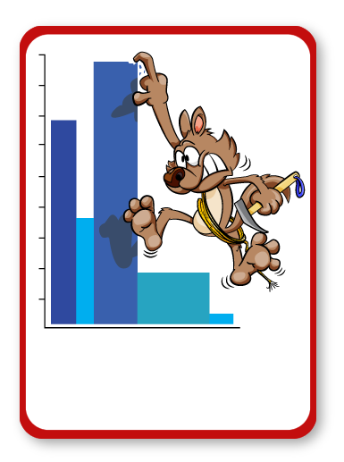
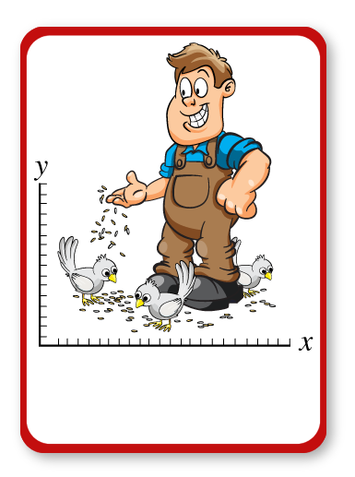
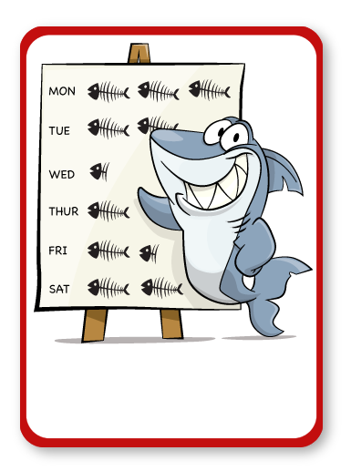
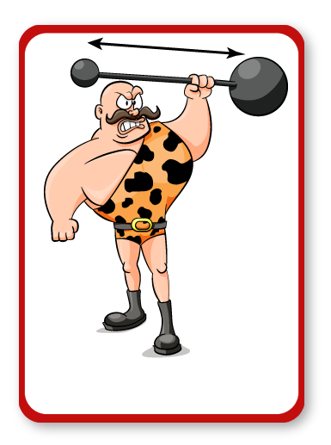
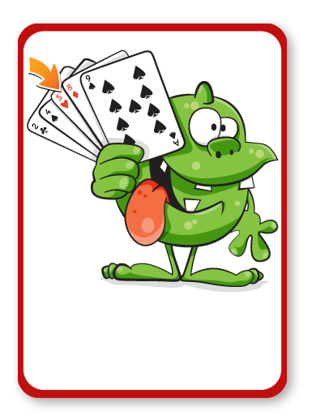
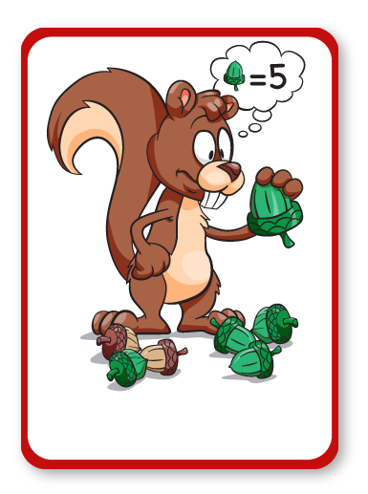
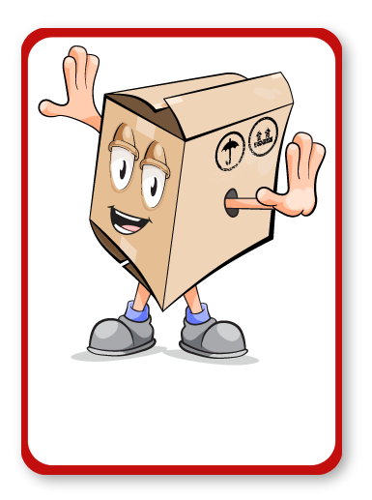
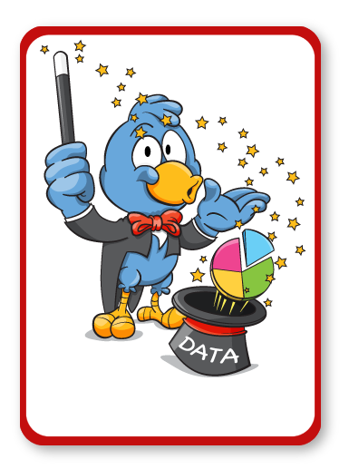
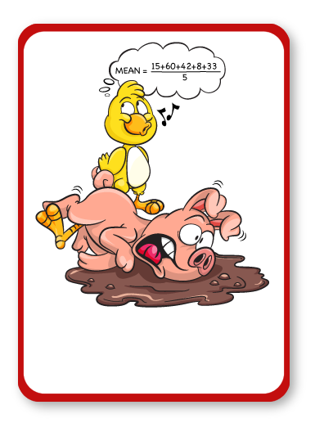
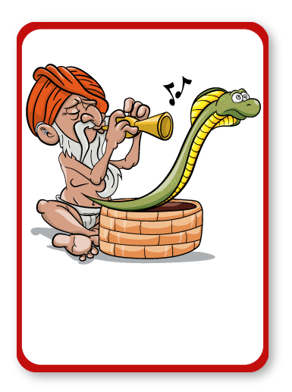
INTERVALS
QUARTILES
PIE CHART
AVERAGE
CHART
HISTOGRAM
SCATTER
PICTOGRAM
RANGE
MEDIAN
FREQUENCY
BOX PLOT
REPRESENT
MEAN
CUMULATIVE

Slide 8
SCATTER

Slide 10
BOX PLOT

Slide 12
CUMULATIVE

Slide 14
RANGE

Slide 16
HISTOGRAM

Slide 17
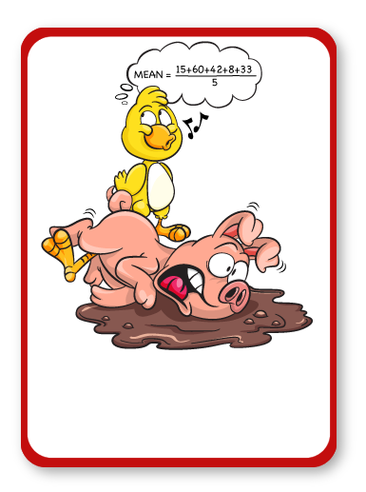

Slide 18
MEAN

Slide 20
MEDIAN

Slide 22
PICTOGRAM

Slide 24
REPRESENT

Slide 26
AVERAGE

Slide 28
INTERVALS

Slide 30
QUARTILES

Slide 32
FREQUENCY

Slide 33
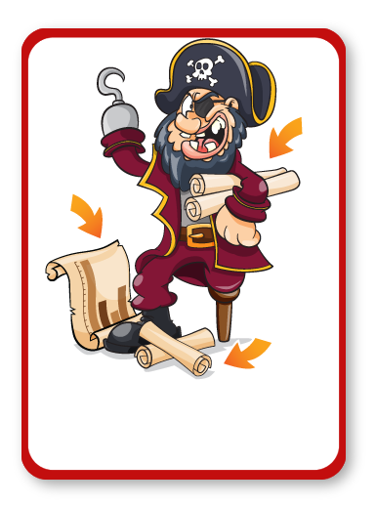

Slide 34
CHARTS

Slide 36
PIE CHART

Slide 37
Notes:
Joke Time
Can students guess the punch line?

Slide 39
Notes:
Bleep
Students work in teams/pairs.
One student picks a word/picture card and then describes it using their knowledge of the word. Decide if you want them to use words, actions or pictures.
They cannot say the word on the card, but they could say bleep instead.
Their team/partner tries to guess the word. You may want to use a timer.
Opposing teams can gain points by listening and writing down other maths words that were used in the description or by challenging when the time runs out.

