Slide 1
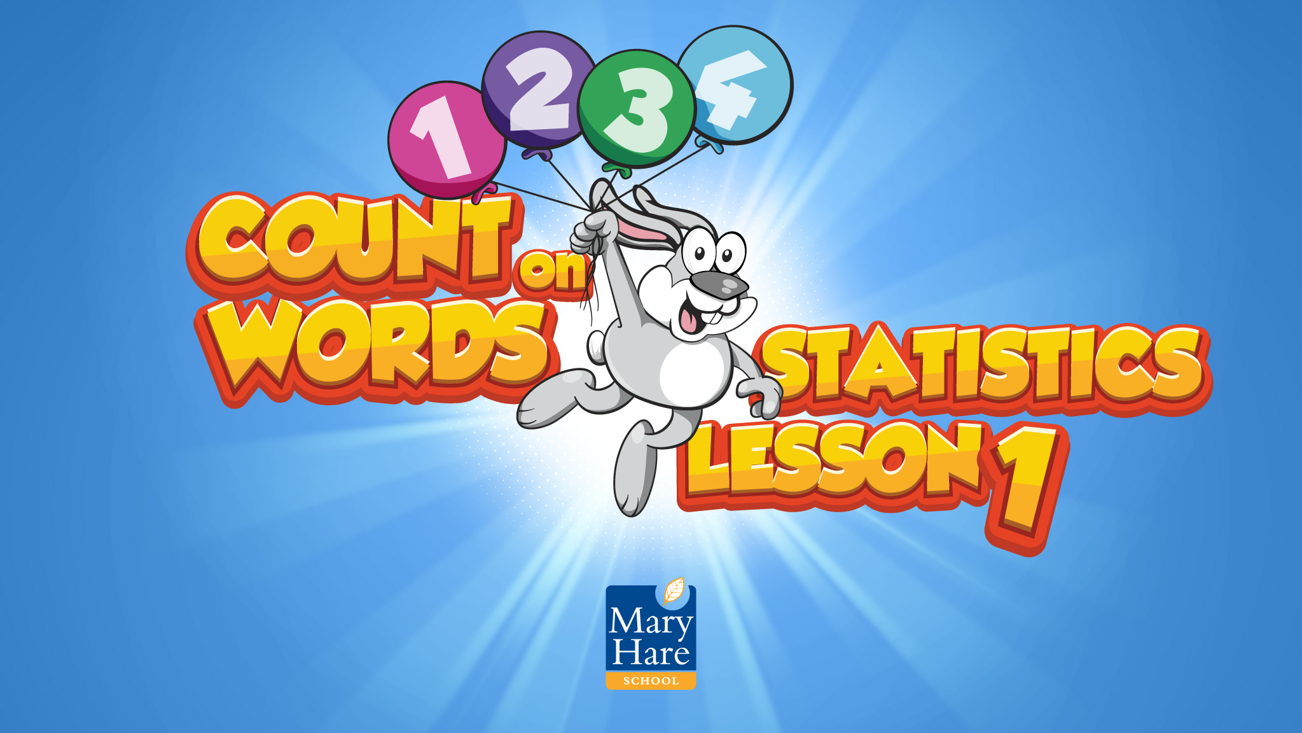

Slide 2
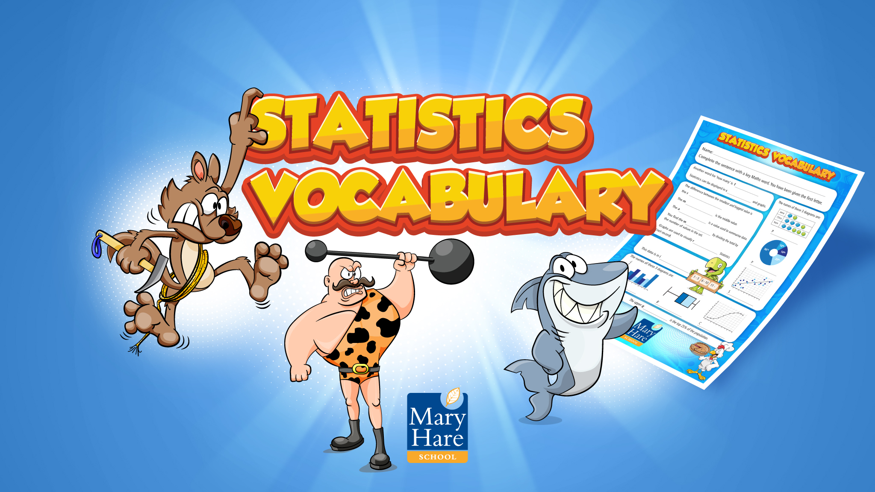
Notes:
Cold test
The vocabulary topic test is completed at the beginning of the intervention which will give a baseline and generate target words.
Students need to complete the missing word. They are given the first letter.
Give the full test or choose how many words to assess based on students needs/ability, e.g. just the first five words.
Apply students’ normal way of working, e.g. you can read the questions to the student.
When marking, allow 2 marks for a fully correct answer, 1 mark if the intention of the word is correct but there is a spelling or word variation error (e.g. day instead of days), 0 if wrong or blank. You will use the results from this to inform the Word Wizard activity.
Do not go through this assessment with the students after to avoid them becoming over familiar with the questions. Use the results to inform the words you focus on in the following lessons.​

Slide 3
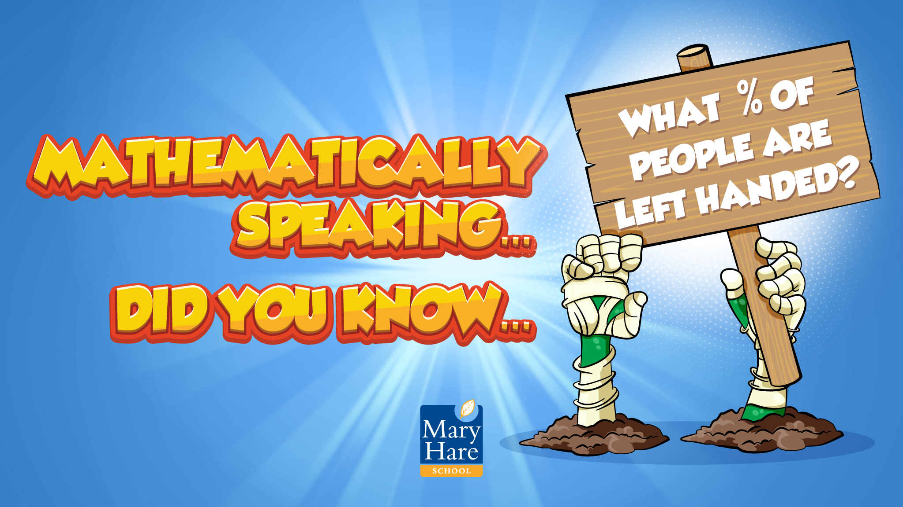
Notes:
Mathematically Speaking
An opportunity to link the topic with other subjects and the wider world. Let the students lead the discussion. Look for opportunities to include target words.
Enrichment opportunity for a conversation about statistics.
Conversation ideas: Ask students what they think the percentage is before revealing the answer.
What is the frequency of people in the room that are left handed?
What frequency of people do you know that are left handed?
How could you represent this information?
Find their average answer, mean, mode, median and range.

Slide 4
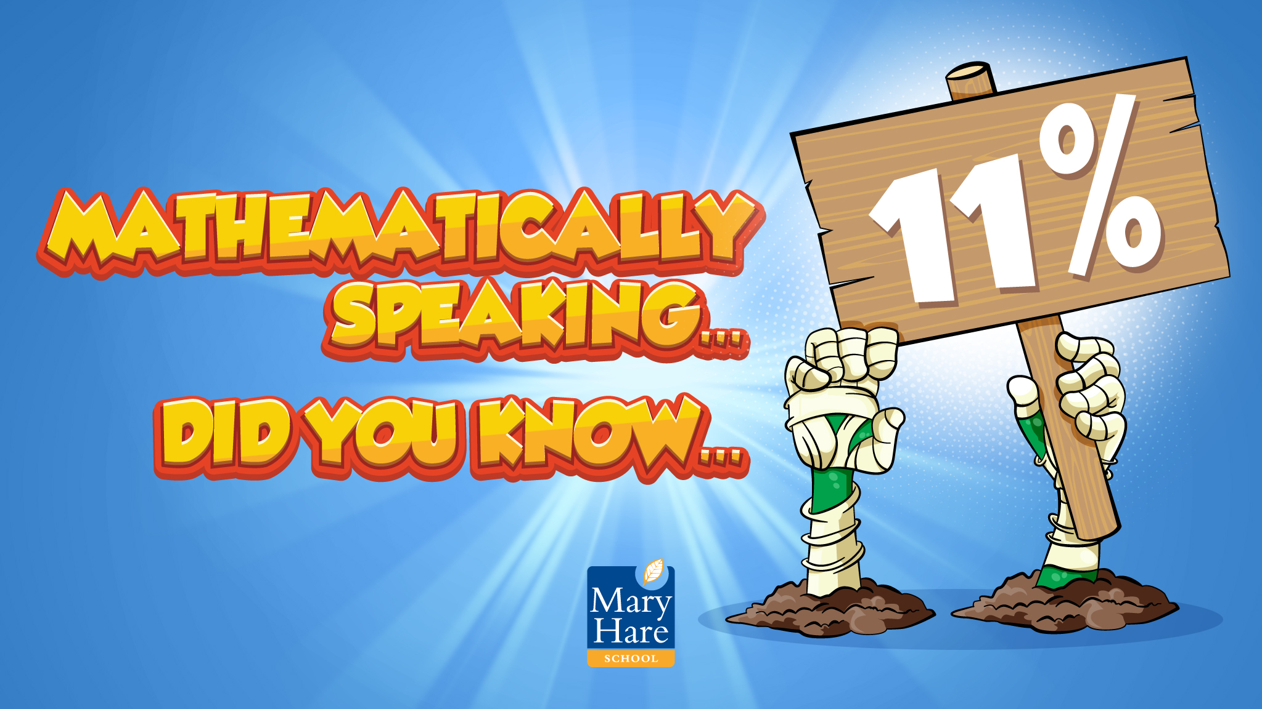
Notes:
Mathematically Speaking
An opportunity to link the topic with other subjects and the wider world. Let the students lead the discussion. Look for opportunities to include target words.
Enrichment opportunity for a conversation about statistics.
Conversation ideas: Ask students what they think the percentage is before revealing the answer.
What is the frequency of people in the room that are left handed?
What frequency of people do you know that are left handed?
How could you represent this information?
Find their average answer, mean, mode, median and range.

Slide 5

Notes:
Kim’s Game
This activity is designed to introduce each topic word. It will also start the process of committing them to memory.
To play the game memorise where the words are. One will be removed. Which one has gone?
12 of the 15 words have been included. Upper, calculator and prime are not included.
You can edit this PowerPoint to remove words that you don’t want to include.

Slide 6

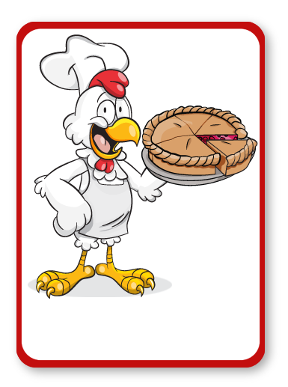
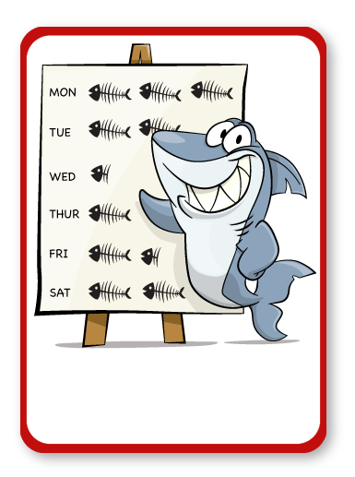
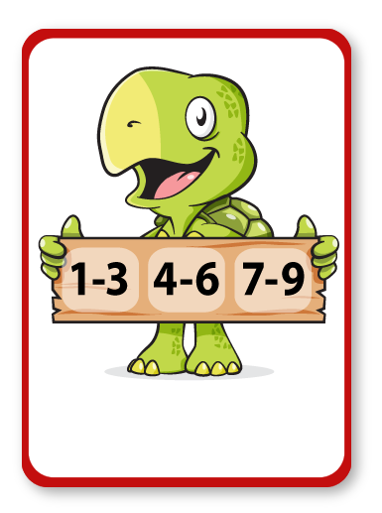
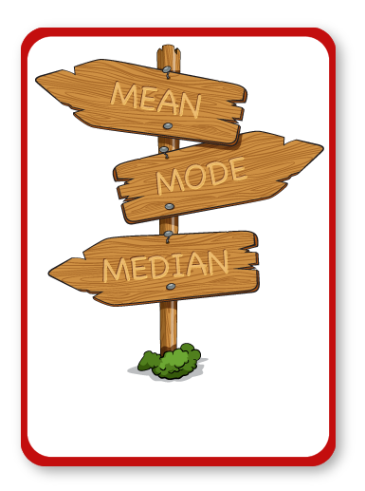
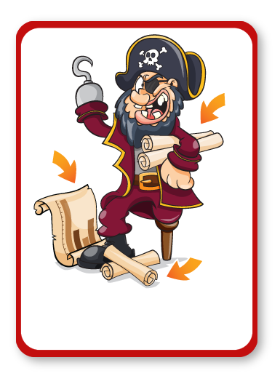
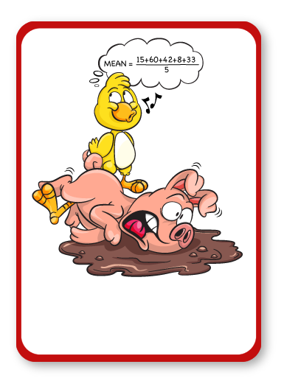
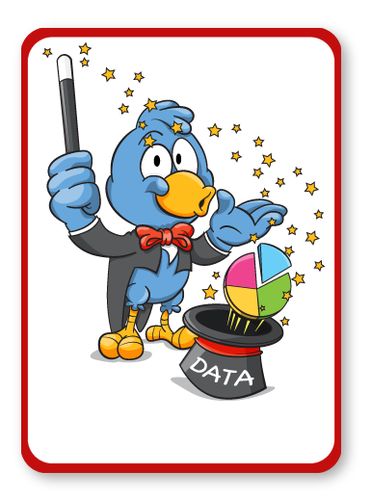
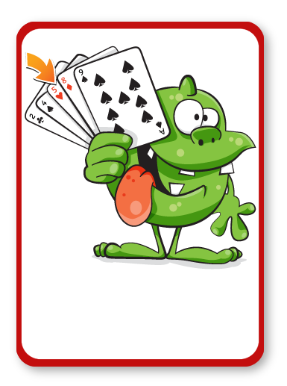
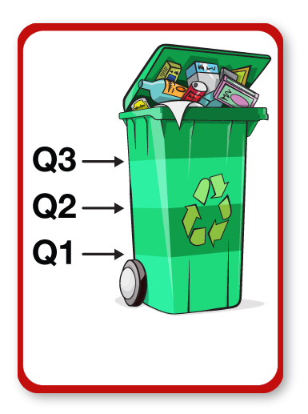
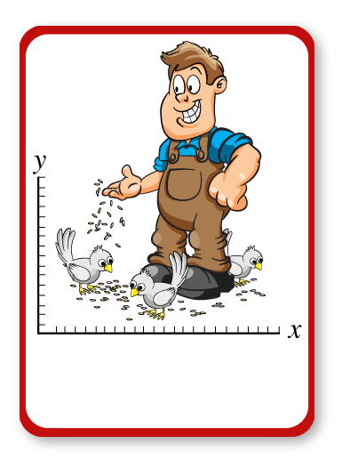
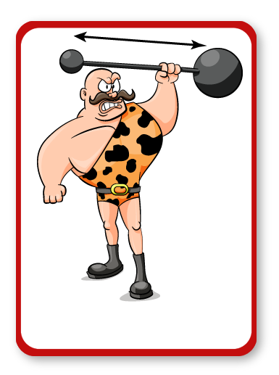
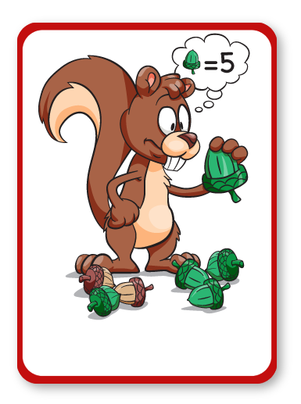
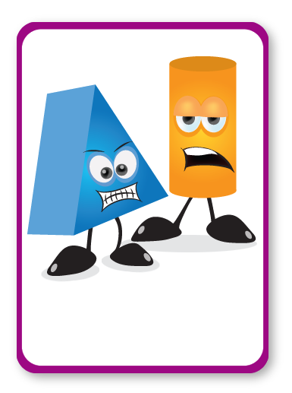
PIE CHART
PICTOGRAM
INTERVALS
AVERAGE
CHART
MEAN
REPRESENT
MEDIAN
QUARTILES
SCATTER
RANGE
FREQUENCY
Notes:
Kim’s Game
Spend time discussing the pictures and words.
Why do you think this picture represents the word?
Look at definitions, pronunciation, spelling, links to Maths and other subjects, synonyms, antonyms, word variations, words with the same root etc.

Slide 7
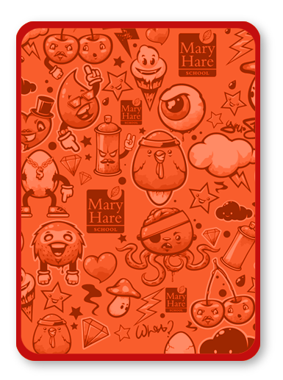
PIE CHART
PICTOGRAM
INTERVALS
CHART
MEAN
REPRESENT
MEDIAN
QUARTILES
SCATTER
RANGE
FREQUENCY
Notes:
Kim’s Game
Spend time discussing the pictures and words.
Why do you think this picture represents the word?
Look at definitions, pronunciation, spelling, links to Maths and other subjects, synonyms, antonyms, word variations, words with the same root etc.

Slide 8
PIE CHART
PICTOGRAM
INTERVALS
AVERAGE
CHART
MEAN
MEDIAN
QUARTILES
SCATTER
RANGE
FREQUENCY
Notes:
Kim’s Game
Spend time discussing the pictures and words.
Why do you think this picture represents the word?
Look at definitions, pronunciation, spelling, links to Maths and other subjects, synonyms, antonyms, word variations, words with the same root etc.

Slide 9
PIE CHART
PICTOGRAM
INTERVALS
AVERAGE
CHART
MEAN
REPRESENT
MEDIAN
QUARTILES
SCATTER
FREQUENCY
Notes:
Kim’s Game
Spend time discussing the pictures and words.
Why do you think this picture represents the word?
Look at definitions, pronunciation, spelling, links to Maths and other subjects, synonyms, antonyms, word variations, words with the same root etc.

Slide 10
PIE CHART
PICTOGRAM
AVERAGE
CHART
MEAN
REPRESENT
MEDIAN
QUARTILES
SCATTER
RANGE
FREQUENCY
Notes:
Kim’s Game
Spend time discussing the pictures and words.
Why do you think this picture represents the word?
Look at definitions, pronunciation, spelling, links to Maths and other subjects, synonyms, antonyms, word variations, words with the same root etc.

Slide 11
PIE CHART
PICTOGRAM
INTERVALS
AVERAGE
CHART
MEAN
REPRESENT
MEDIAN
QUARTILES
SCATTER
RANGE
Notes:
Kim’s Game
Spend time discussing the pictures and words.
Why do you think this picture represents the word?
Look at definitions, pronunciation, spelling, links to Maths and other subjects, synonyms, antonyms, word variations, words with the same root etc.

Slide 12
PIE CHART
PICTOGRAM
INTERVALS
AVERAGE
CHART
MEAN
REPRESENT
MEDIAN
QUARTILES
RANGE
FREQUENCY
Notes:
Kim’s Game
Spend time discussing the pictures and words.
Why do you think this picture represents the word?
Look at definitions, pronunciation, spelling, links to Maths and other subjects, synonyms, antonyms, word variations, words with the same root etc.

Slide 13
PIE CHART
INTERVALS
AVERAGE
CHART
MEAN
REPRESENT
MEDIAN
QUARTILES
SCATTER
RANGE
FREQUENCY
Notes:
Kim’s Game
Spend time discussing the pictures and words.
Why do you think this picture represents the word?
Look at definitions, pronunciation, spelling, links to Maths and other subjects, synonyms, antonyms, word variations, words with the same root etc.

Slide 14
PIE CHART
PICTOGRAM
INTERVALS
AVERAGE
CHART
REPRESENT
MEDIAN
QUARTILES
SCATTER
RANGE
FREQUENCY
Notes:
Kim’s Game
Spend time discussing the pictures and words.
Why do you think this picture represents the word?
Look at definitions, pronunciation, spelling, links to Maths and other subjects, synonyms, antonyms, word variations, words with the same root etc.

Slide 15
PIE CHART
PICTOGRAM
INTERVALS
AVERAGE
CHART
MEAN
REPRESENT
MEDIAN
SCATTER
RANGE
FREQUENCY
Notes:
Kim’s Game
Spend time discussing the pictures and words.
Why do you think this picture represents the word?
Look at definitions, pronunciation, spelling, links to Maths and other subjects, synonyms, antonyms, word variations, words with the same root etc.

Slide 16
PIE CHART
PICTOGRAM
INTERVALS
AVERAGE
MEAN
REPRESENT
MEDIAN
QUARTILES
SCATTER
RANGE
FREQUENCY
Notes:
Kim’s Game
Spend time discussing the pictures and words.
Why do you think this picture represents the word?
Look at definitions, pronunciation, spelling, links to Maths and other subjects, synonyms, antonyms, word variations, words with the same root etc.

Slide 17
PICTOGRAM
INTERVALS
AVERAGE
CHART
MEAN
REPRESENT
MEDIAN
QUARTILES
SCATTER
RANGE
FREQUENCY
Notes:
Kim’s Game
Spend time discussing the pictures and words.
Why do you think this picture represents the word?
Look at definitions, pronunciation, spelling, links to Maths and other subjects, synonyms, antonyms, word variations, words with the same root etc.

Slide 18
PIE CHART
PICTOGRAM
INTERVALS
AVERAGE
CHART
MEAN
REPRESENT
QUARTILES
SCATTER
RANGE
FREQUENCY
Notes:
Kim’s Game
Spend time discussing the pictures and words.
Why do you think this picture represents the word?
Look at definitions, pronunciation, spelling, links to Maths and other subjects, synonyms, antonyms, word variations, words with the same root etc.

Slide 19

Notes:
Can students guess the punch line?

Slide 20
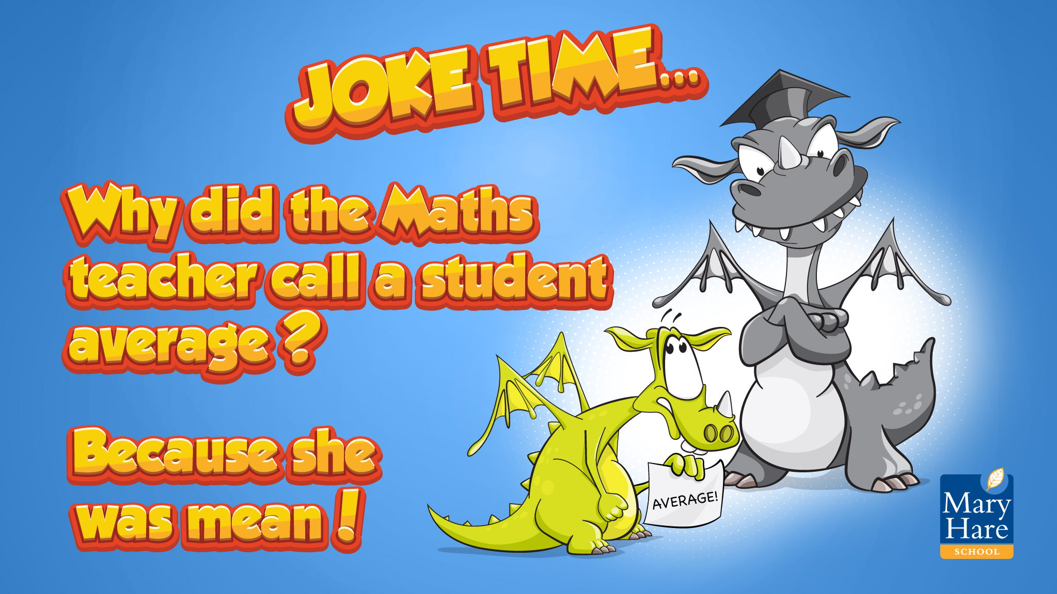

Slide 21

Notes:
I went to the market…
Working in small groups, a student names one of the topic words e.g. triangle, the next student has to repeat their word and name another e.g. estimate, multiple.
Continue for as long as the memory will allow!
You may want to display the words from Kim’s game to support the students.

