Slide 2
Notes:
Cold test
The vocabulary topic test is completed at the beginning of the intervention which will give a baseline and generate target words.
Students need to complete the missing word. They are given the first letter.
Give the full test or choose how many words to assess based on students needs/ability, e.g. just the first five words.
Apply students’ normal way of working, e.g. you can read the questions to the student.
When marking, allow 2 marks for a fully correct answer, 1 mark if the intention of the word is correct but there is a spelling or word variation error (e.g. day instead of days), 0 if wrong or blank. You will use the results from this to inform the Word Wizard activity.
Do not go through this assessment with the students after to avoid them becoming overfamiliar with the questions. Use the results to inform the words you focus on in the following lessons.​

Slide 3
Notes:
Mathematically Speaking
An opportunity to link the topic with other subjects and the wider world.
Let the students lead the discussion. Look for opportunities to include target words.
Conversation ideas: Roman numerals, Salvador Dali, art in Maths
Research Salvador Dali art work. What do you think the wonky clock represents?

Slide 4
Notes:
Kim’s Game
This activity is designed to introduce each topic word. It will also start the process of committing them to memory.
To play the game memorise where the words are. One will be removed. Which one has gone?
12 of the 15 words have been included. Once, seconds and year are not included.
You can edit this PowerPoint to change the words you want to include.

Slide 5
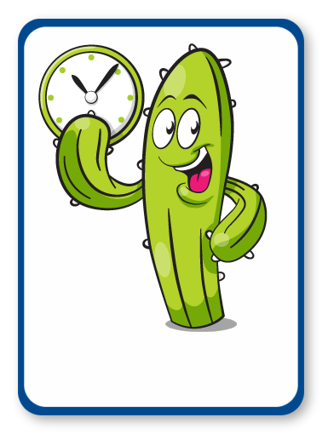
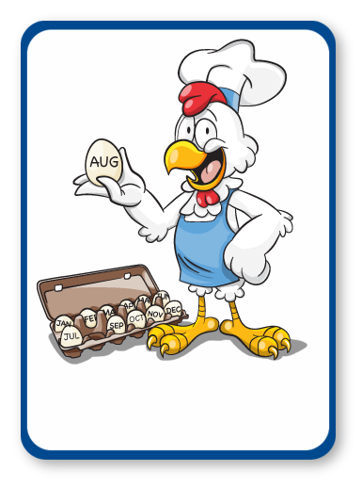
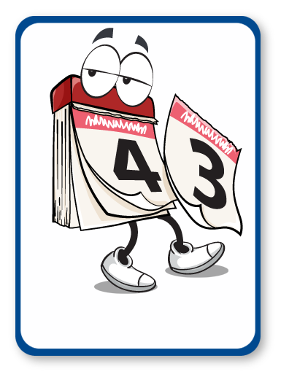
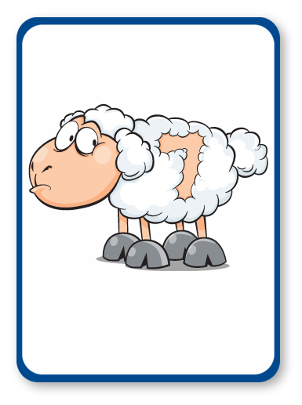
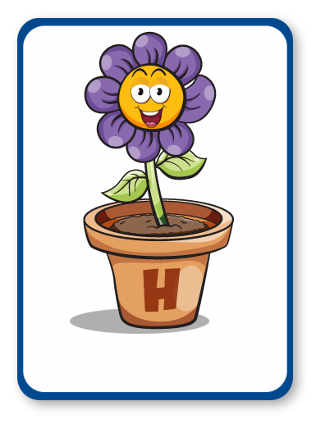
LONGEST
FIRST
TIME
MONTH
TWICE
DAYS
WEEK
HOUR
MINUTES
PER ANNUM
SHORTEST
MONDAY
Notes:
Kim’s Game
Spend time discussing the pictures and words.
Why do you think this picture represents the word?
Look at definitions, pronunciation, spelling, links to Maths and other subjects, synonyms, antonyms, word variations, words with the same root etc.

Slide 6
LONGEST
FIRST
MONTH
TWICE
DAYS
WEEK
HOUR
MINUTES
PER ANNUM
SHORTEST
MONDAY
Notes:
Kim’s Game
Spend time discussing the pictures and words.
Why do you think this picture represents the word?
Look at definitions, pronunciation, spelling, links to Maths and other subjects, synonyms, antonyms, word variations, words with the same root etc.

Slide 7
LONGEST
FIRST
TIME
MONTH
TWICE
DAYS
WEEK
HOUR
MINUTES
PER ANNUM
SHORTEST
MONDAY
Notes:
Kim’s Game
Spend time discussing the pictures and words.
Why do you think this picture represents the word?
Look at definitions, pronunciation, spelling, links to Maths and other subjects, synonyms, antonyms, word variations, words with the same root etc.

Slide 8
LONGEST
FIRST
TIME
MONTH
TWICE
DAYS
HOUR
MINUTES
PER ANNUM
SHORTEST
MONDAY
Notes:
Kim’s Game
Spend time discussing the pictures and words.
Why do you think this picture represents the word?
Look at definitions, pronunciation, spelling, links to Maths and other subjects, synonyms, antonyms, word variations, words with the same root etc.

Slide 9
LONGEST
FIRST
TIME
MONTH
TWICE
DAYS
WEEK
HOUR
MINUTES
PER ANNUM
SHORTEST
MONDAY
Notes:
Kim’s Game
Spend time discussing the pictures and words.
Why do you think this picture represents the word?
Look at definitions, pronunciation, spelling, links to Maths and other subjects, synonyms, antonyms, word variations, words with the same root etc.

Slide 10
LONGEST
FIRST
TIME
MONTH
TWICE
DAYS
WEEK
HOUR
MINUTES
SHORTEST
MONDAY
Notes:
Kim’s Game
Spend time discussing the pictures and words.
Why do you think this picture represents the word?
Look at definitions, pronunciation, spelling, links to Maths and other subjects, synonyms, antonyms, word variations, words with the same root etc.

Slide 11
LONGEST
FIRST
TIME
MONTH
TWICE
DAYS
WEEK
HOUR
MINUTES
PER ANNUM
SHORTEST
MONDAY
Notes:
Kim’s Game
Spend time discussing the pictures and words.
Why do you think this picture represents the word?
Look at definitions, pronunciation, spelling, links to Maths and other subjects, synonyms, antonyms, word variations, words with the same root etc.

Slide 12
LONGEST
FIRST
TIME
MONTH
TWICE
WEEK
HOUR
MINUTES
PER ANNUM
SHORTEST
MONDAY
Notes:
Kim’s Game
Spend time discussing the pictures and words.
Why do you think this picture represents the word?
Look at definitions, pronunciation, spelling, links to Maths and other subjects, synonyms, antonyms, word variations, words with the same root etc.

Slide 13
LONGEST
FIRST
TIME
MONTH
TWICE
DAYS
WEEK
HOUR
MINUTES
PER ANNUM
SHORTEST
MONDAY
Notes:
Kim’s Game
Spend time discussing the pictures and words.
Why do you think this picture represents the word?
Look at definitions, pronunciation, spelling, links to Maths and other subjects, synonyms, antonyms, word variations, words with the same root etc.

Slide 14
FIRST
TIME
MONTH
TWICE
DAYS
WEEK
HOUR
MINUTES
PER ANNUM
SHORTEST
MONDAY
Notes:
Kim’s Game
Spend time discussing the pictures and words.
Why do you think this picture represents the word?
Look at definitions, pronunciation, spelling, links to Maths and other subjects, synonyms, antonyms, word variations, words with the same root etc.

Slide 15
LONGEST
FIRST
TIME
MONTH
TWICE
DAYS
WEEK
HOUR
MINUTES
PER ANNUM
SHORTEST
MONDAY
Notes:
Kim’s Game
Spend time discussing the pictures and words.
Why do you think this picture represents the word?
Look at definitions, pronunciation, spelling, links to Maths and other subjects, synonyms, antonyms, word variations, words with the same root etc.

Slide 16
LONGEST
FIRST
TIME
MONTH
TWICE
DAYS
WEEK
MINUTES
PER ANNUM
SHORTEST
MONDAY
Notes:
Kim’s Game
Spend time discussing the pictures and words.
Why do you think this picture represents the word?
Look at definitions, pronunciation, spelling, links to Maths and other subjects, synonyms, antonyms, word variations, words with the same root etc.

Slide 17
LONGEST
FIRST
TIME
MONTH
TWICE
DAYS
WEEK
HOUR
MINUTES
PER ANNUM
SHORTEST
MONDAY
Notes:
Kim’s Game
Spend time discussing the pictures and words.
Why do you think this picture represents the word?
Look at definitions, pronunciation, spelling, links to Maths and other subjects, synonyms, antonyms, word variations, words with the same root etc.

Slide 18
LONGEST
FIRST
TIME
MONTH
DAYS
WEEK
HOUR
MINUTES
PER ANNUM
SHORTEST
MONDAY
Notes:
Kim’s Game
Spend time discussing the pictures and words.
Why do you think this picture represents the word?
Look at definitions, pronunciation, spelling, links to Maths and other subjects, synonyms, antonyms, word variations, words with the same root etc.

Slide 19
LONGEST
FIRST
TIME
MONTH
TWICE
DAYS
WEEK
HOUR
MINUTES
PER ANNUM
SHORTEST
MONDAY
Notes:
Kim’s Game
Spend time discussing the pictures and words.
Why do you think this picture represents the word?
Look at definitions, pronunciation, spelling, links to Maths and other subjects, synonyms, antonyms, word variations, words with the same root etc.

Slide 20
LONGEST
FIRST
TIME
MONTH
TWICE
DAYS
WEEK
HOUR
PER ANNUM
SHORTEST
MONDAY
Notes:
Kim’s Game
Spend time discussing the pictures and words.
Why do you think this picture represents the word?
Look at definitions, pronunciation, spelling, links to Maths and other subjects, synonyms, antonyms, word variations, words with the same root etc.

Slide 21
LONGEST
FIRST
TIME
MONTH
TWICE
DAYS
WEEK
HOUR
MINUTES
PER ANNUM
SHORTEST
MONDAY
Notes:
Kim’s Game
Spend time discussing the pictures and words.
Why do you think this picture represents the word?
Look at definitions, pronunciation, spelling, links to Maths and other subjects, synonyms, antonyms, word variations, words with the same root etc.

Slide 22
LONGEST
FIRST
TIME
MONTH
TWICE
DAYS
WEEK
HOUR
MINUTES
PER ANNUM
SHORTEST
Notes:
Kim’s Game
Spend time discussing the pictures and words.
Why do you think this picture represents the word?
Look at definitions, pronunciation, spelling, links to Maths and other subjects, synonyms, antonyms, word variations, words with the same root etc.

Slide 23
LONGEST
FIRST
TIME
MONTH
TWICE
DAYS
WEEK
HOUR
MINUTES
PER ANNUM
SHORTEST
MONDAY
Notes:
Kim’s Game
Spend time discussing the pictures and words.
Why do you think this picture represents the word?
Look at definitions, pronunciation, spelling, links to Maths and other subjects, synonyms, antonyms, word variations, words with the same root etc.

Slide 24
LONGEST
FIRST
TIME
TWICE
DAYS
WEEK
HOUR
MINUTES
PER ANNUM
SHORTEST
MONDAY
Notes:
Kim’s Game
Spend time discussing the pictures and words.
Why do you think this picture represents the word?
Look at definitions, pronunciation, spelling, links to Maths and other subjects, synonyms, antonyms, word variations, words with the same root etc.

Slide 25
LONGEST
FIRST
TIME
MONTH
TWICE
DAYS
WEEK
HOUR
MINUTES
PER ANNUM
SHORTEST
MONDAY
Notes:
Kim’s Game
Spend time discussing the pictures and words.
Why do you think this picture represents the word?
Look at definitions, pronunciation, spelling, links to Maths and other subjects, synonyms, antonyms, word variations, words with the same root etc.

Slide 26
LONGEST
FIRST
TIME
MONTH
TWICE
DAYS
WEEK
HOUR
MINUTES
PER ANNUM
MONDAY
Notes:
Kim’s Game
Spend time discussing the pictures and words.
Why do you think this picture represents the word?
Look at definitions, pronunciation, spelling, links to Maths and other subjects, synonyms, antonyms, word variations, words with the same root etc.

Slide 27
LONGEST
FIRST
TIME
MONTH
TWICE
DAYS
WEEK
HOUR
MINUTES
PER ANNUM
SHORTEST
MONDAY
Notes:
Kim’s Game
Spend time discussing the pictures and words.
Why do you think this picture represents the word?
Look at definitions, pronunciation, spelling, links to Maths and other subjects, synonyms, antonyms, word variations, words with the same root etc.

Slide 28
LONGEST
TIME
MONTH
TWICE
DAYS
WEEK
HOUR
MINUTES
PER ANNUM
SHORTEST
MONDAY
Notes:
Kim’s Game
Spend time discussing the pictures and words.
Why do you think this picture represents the word?
Look at definitions, pronunciation, spelling, links to Maths and other subjects, synonyms, antonyms, word variations, words with the same root etc.

Slide 29
LONGEST
FIRST
TIME
MONTH
TWICE
DAYS
WEEK
HOUR
MINUTES
PER ANNUM
SHORTEST
MONDAY
Notes:
Kim’s Game
Spend time discussing the pictures and words.
Why do you think this picture represents the word?
Look at definitions, pronunciation, spelling, links to Maths and other subjects, synonyms, antonyms, word variations, words with the same root etc.

Slide 30
Notes:
Joke Time
Can students guess the punch line?

Slide 31
Notes:
Joke Time
Can students guess the punch line?

Slide 32
Notes:
I went to the market…
Working in small groups, a student names one of the topic words e.g. minute, the next student has to repeat their word and name another e.g. minute, week.
Continue for as long as the memory will allow!
You may want to display the words from Kim’s game to support the students.

